Slide 1

Algorithms and Data Structures 2 CS 1501
Spring 2022
Sherif Khattab
ksm73@pitt.edu
(Slides are adapted from Dr. Ramirez’s and Dr. Farnan’s CS1501 slides.)

Slide 2
Announcements
Upcoming deadlines:
Homework 11 due on 4/11
Lab 11 due on 4/15
Homework 12 due on 4/18
Assignment 3 and 4 due on 4/18

Slide 3
Previous lecture …
Integer Multiplication
Karatsuba’s algorithm
Divide and conquer
Reduce the number of subproblems

Slide 4
CourseMIRROR Reflections (most confusing)
The concept of a minimum st-cut was most confusing today.
how to find st-cut
Which edges are counted for min ST cuts? What does it have to do with being reachable by S
when talking about max flow, is it the flow over each edge or do you add up the flows of each edge on the path?
Is there any connection between articulation points (if there are a direct path between two articulation points) and st-cut path. It seems as similar, as the whole graph can to maintain being connected/hold max flow
It’d be nice to see a formalized algorithm for priority first search
karatsuba is still confusing as to what exactly is happening.
The multiplication algorithms and their runtime
euclids algorithm

Slide 5
CourseMIRROR Reflections (most interesting)
Seeing the difference between gradeschool multiplication and karatsuba’s multiplication
Optimizing multiplication based on bits and decreasing the number of multiplies
Seeing new multiplication algorithms.
The Integer Multiplication Problem and its associated algorithms was most interesting.
the different multiplication algorithms were hard to follow but still interesting
I found Karatsubas Algorithm to be interesting, using the sum of all 4 multiplications to reduce total multiplications to 3 was cool
How to find the ST-cuts and how max flow = min cut
backedges as a way to undo previous selections
Graph
The maximum spanning tree used to do the PFS
Ford Fulkerson applications

Slide 6
Assignment 4 Hint
tripsWithin(budget)
Returns a set of paths whose total cost <= a given budget
Backtracking
Recursive helper method
Solve(current decision, current solution)
Current decision
Current vertex
Current solution
The set of paths so far
The current path
The remaining balance

Slide 7
Assignment 4 Hint
Inside the recursive method
Iterative over neighbors of current vertex
If neighbor is not marked and edge price <= remaining balance
Add neighbor to current path
Add a copy of current path to the set of paths
Mark the neighbor
Recur on the neighbor
Unmark the neighbor
Remove the neighbor from current path

Slide 8
Problem of the Day: Cryptography
Cryptography - enabling secure communication in the presence of third parties
Alice wants to send Bob a message without anyone else being able to read it
Alice
M
Encrypt
C
Decrypt
M
Bob

Slide 9
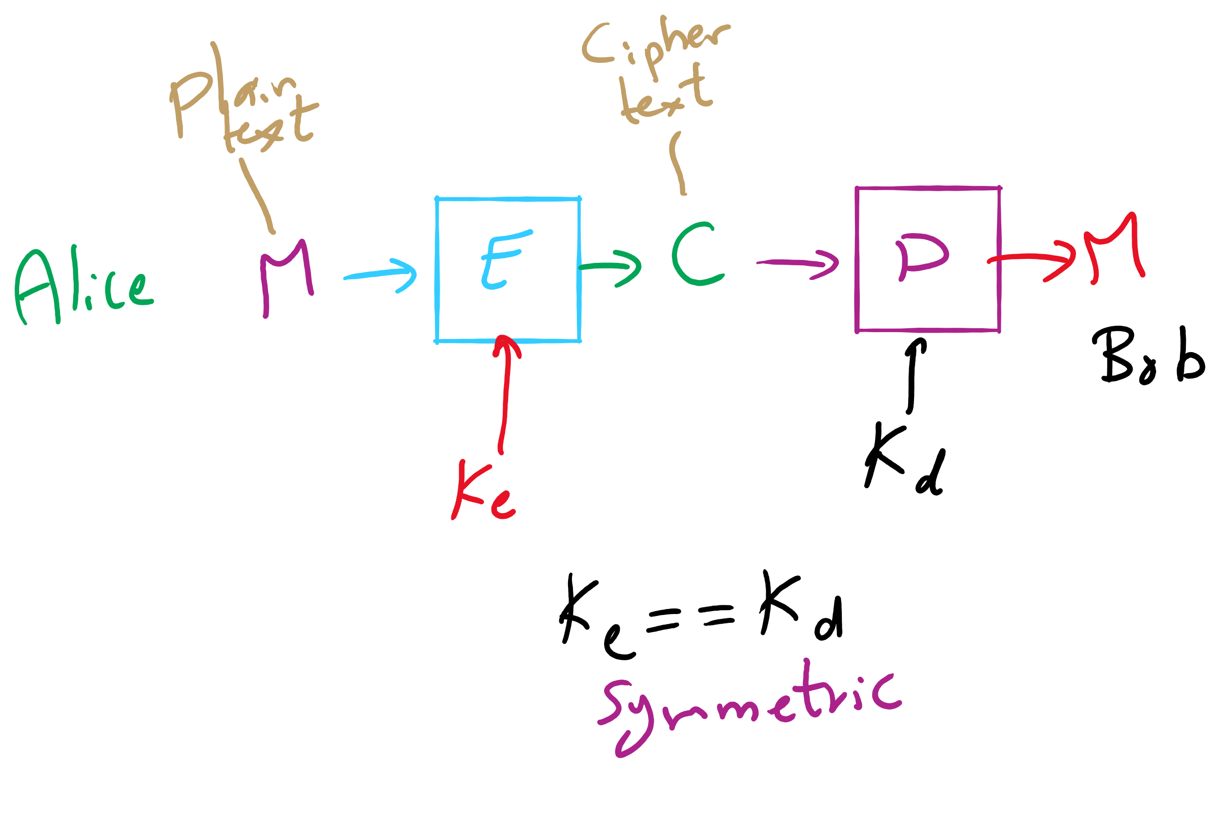
Encryption Model

Slide 10
Enter the adversary
Consider the adversary to be anyone that could try to eavesdrop on Alice and Bob communicating
People in the same coffee shop as Alice or Bob as they talk over WiFi
Admins operating the network between Alice and Bob
And mirroring their traffic to the NSA…
Will have access to:
The ciphertext
The encrypted message
The encryption algorithm
At least Alice and Bob should assume the adversary does
The key material is the only thing Bob knows that the adversary does not

Slide 11
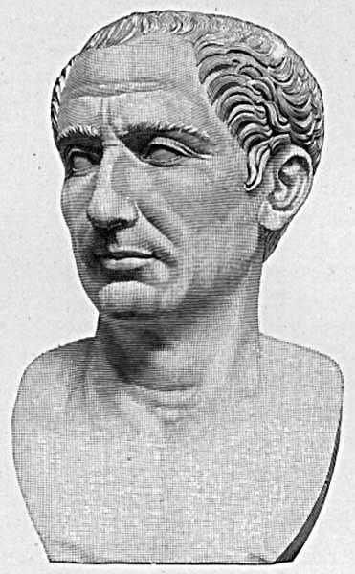
Cryptography has been around for some time
Early, classic encryption scheme:
Caesar cipher:
“Shift” the alphabet by a set amount
Use this shifted alphabet to send messages
The “key” is the amount the alphabet is shifted
Yes, that Caesar
Alphabet
ABCDEFGHIJKLMNOPQRSTUVWXYZ
XYZABCDEFGHIJKLMNOPQRSTUVW
Shift 3
Notes:
ROT3(OVALTINE) = LSXIQFKB

Slide 12
By modern standards, incredibly easy to crack
BRUTE FORCE
Try every possible shift
25 options for the English alphabet
255 for ASCII
OK, let's make it harder to brute force
Instead of using a shifted alphabet, let's use a random permutation of the alphabet
Key is now this permutation, not just a shift value
R size alphabet means R! possible permutations!

Slide 13
By modern standards, incredibly easy to crack
Just requires a bit more sophisticated of an algorithm
Analyzing encrypted English for example
Sentences have a given structure
Character frequencies are skewed
Essentially playing Wheel of Fortune

Slide 14
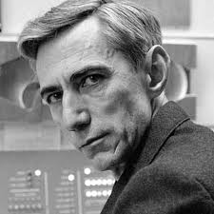
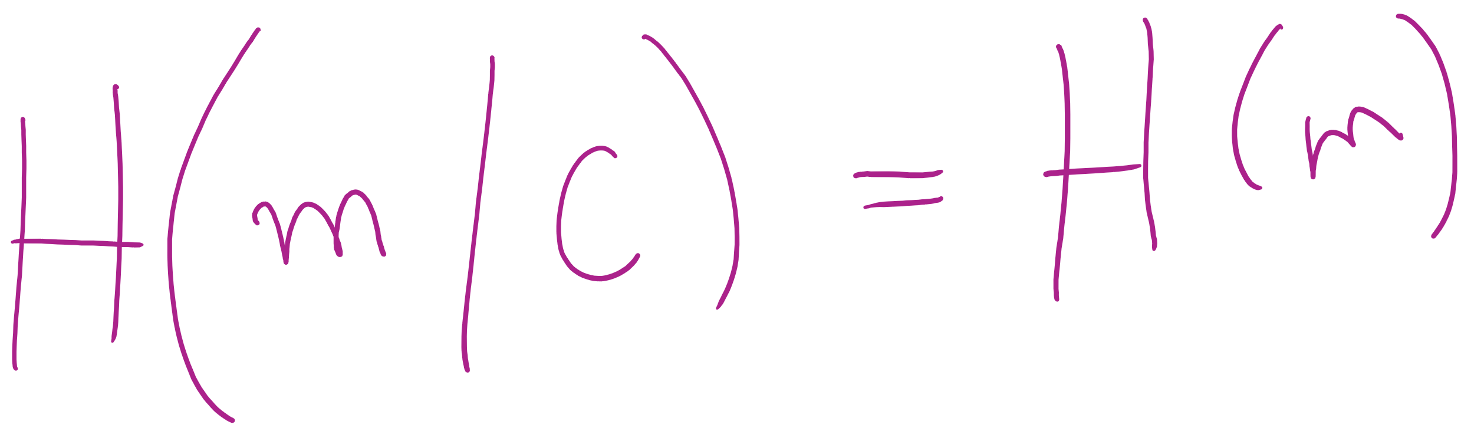
So what is a good cipher?
One-time pads
List of one-time use keys (called a pad) here
To send a message:
Take an unused pad
Use modular addition to combine key with message
For binary data, XOR
Send to recipient
Upon receiving a message:
Take the next pad
Use modular subtraction to combine key with message
For binary data, XOR
Read result
Proven to provide perfect secrecy

Slide 15
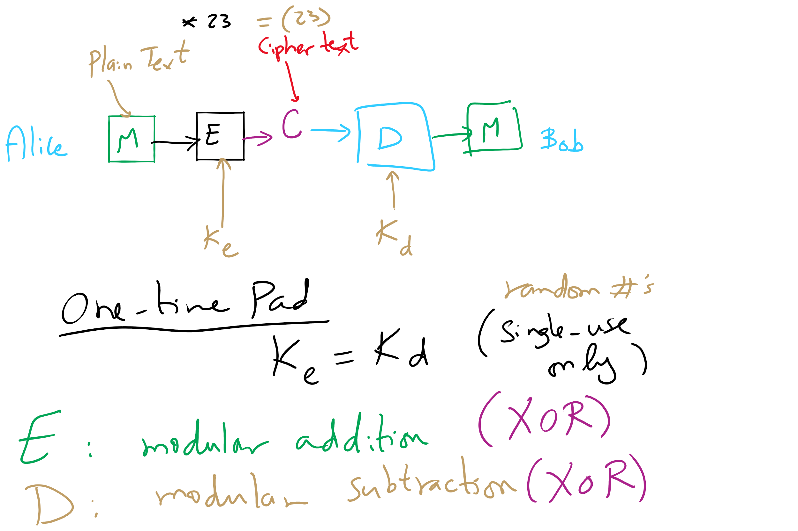
One-Time Pad

Slide 16
One-time pad example
Encoding:
0 1 2 3 4 5 6 7 8 9 10 11 12 13 14 15 16 17 18 19 20 21 22 23 24 25
A B C D E F G H I J K L M N O P Q R S T U V W X Y Z
Message:
H E L L O
Pad:
Q J C W T
7 4 11 11 14
16 9 2 22 19
+
16 9 2 22 19
(mod 26)
23 13 13 7 7
Encrypted Message:
X N N H H
23 13 13 7 7
-
16 9 2 22 19
(mod 26)
7 4 11 11 14
H E L L O
Notes:
Live demo perfect forward secrecy. Have students pick any other 5 character string and find the codeword.
Ex: WORLD = (22, 14, 17, 11, 3)
pad should be (1, 25, 22, 22, 4) = BZWWE

Slide 17
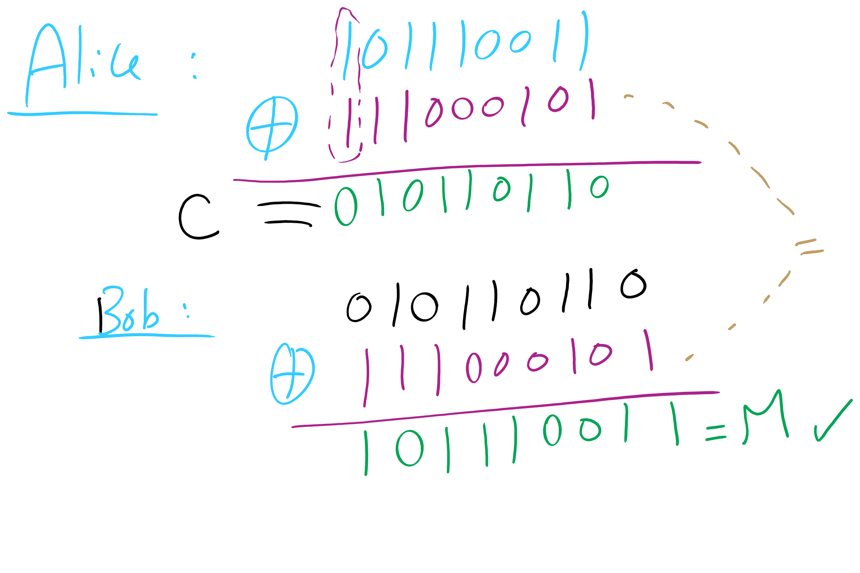
One-Time Pad Example 1

Slide 18
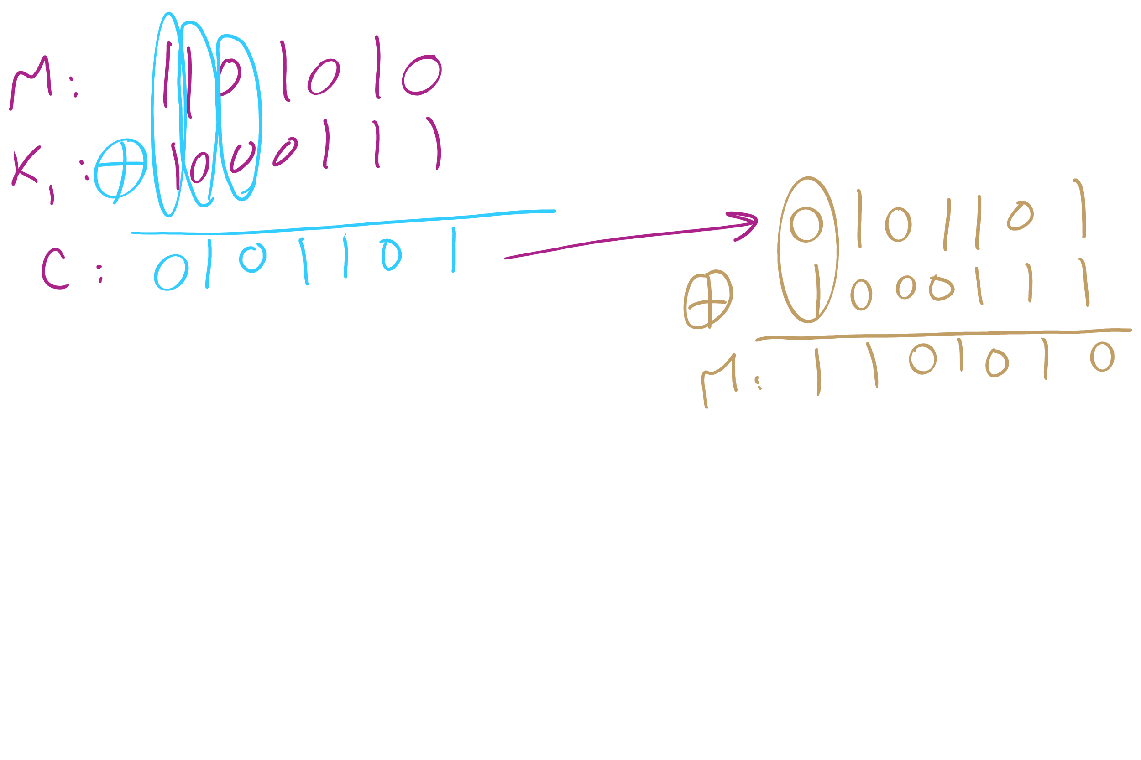
One-Time Pad Example 2

Slide 19
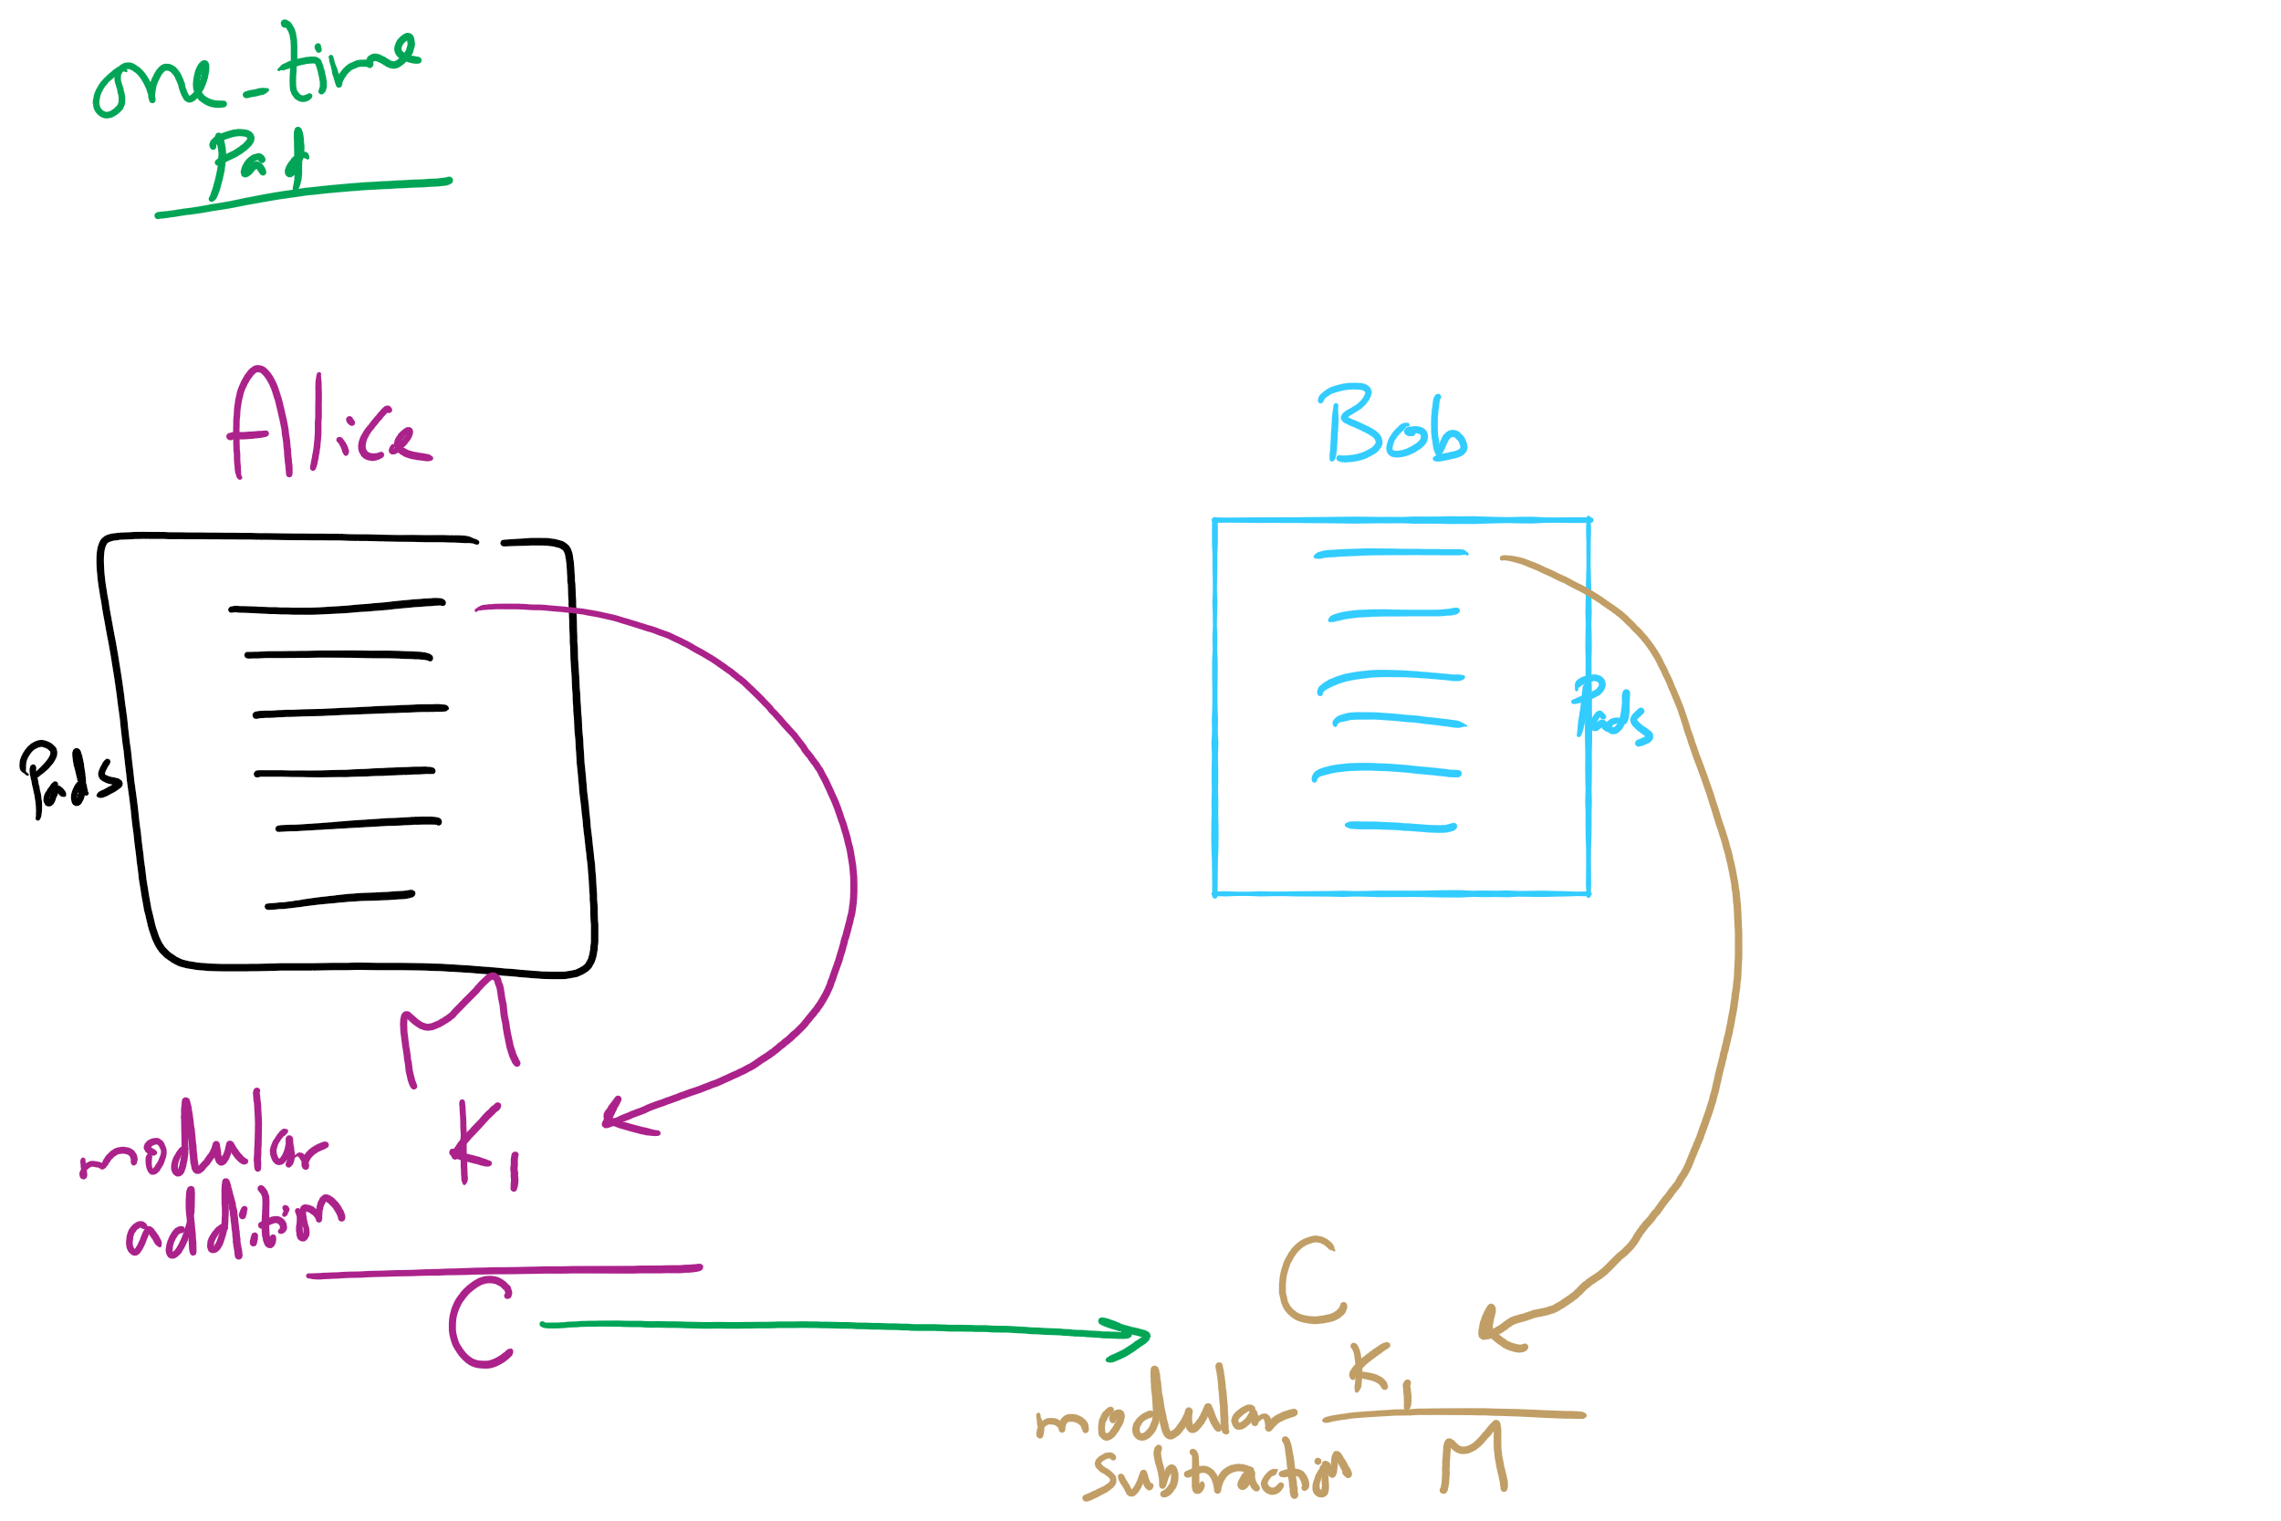
One-Time Pad

Slide 20
Difficulties with one-time pads
Pads must be truly random
Both sender and receiver must have a matched list of pads in the appropriate order
Once you run out of pads, no more messages can be sent

Slide 21
Symmetric ciphers
Alice
M
Encrypt
C
Decrypt
M
Bob
K
K
E.g., DES, AES, Blowfish
Users share a single key
Numbers of a given bitlength (e.g., 128, 256)
Key is used to encrypt/decrypt many messages back and forth
Encryptions/decryptions will be fast
Typically linear in the size the input
Ciphertext should appear random
Best way to recover plaintext should be a brute force attack on the encryption key
Which we have shown to be infeasible for 128bit AES keys

Slide 22
Problems with symmetric ciphers
Alice and Bob have to both know the same key
How can you securely transmit the key from Alice to Bob?
Further, if Alice also wants to communicate with Charlie, her and Charlie will need to know the same key, a different key from the key Alice shares with Bob
Alice and Danielle will also have to share a different key…
etc.

Slide 23
Enter public-key encryption
Each user has their own pair of keys
A public key that can be revealed to anyone
A private key that only they should know
How does this solve our problem?
Public key can simply be published/advertised
Posted repositories of public keys
Added to an email signature
Each user is responsible only for their own keypair
Let's look at a public-key crypto scheme in detail...

Slide 24
RSA Cryptosystem in-depth
What are RSA keypairs?
How messages encrypted?
How are messages decrypted?
How are keys generated?
Why is it secure?

Slide 25
RSA keypairs
Public key is two numbers, which we will call n and e
Private key is a single number we will call d
The length of n in bits is the key length
I.e., 2048 bit RSA keys will have a 2048 bit n value
Note that "n" will be used to indicate the RSA public key component for our discussion of RSA...

Slide 26
Encryption
Say Alice wants to send a message to Bob
Looks up Bob’s public key
Convert the message into an integer: m
Compute the ciphertext c as:
c = m^{e} (mod n)
Send c to Bob

Slide 27
Decryption
Bob can simply:
Compute m as:
m = c^{d} (mod n)
Convert m into Alice’s message

Slide 28
Really?
What??!!

Slide 29
n, e, and d need to be carefully generated
Choose two prime numbers p and q
Compute n = p * q
Compute φ(n)
φ(n) = φ(p) * φ(q) = (p - 1) * (q - 1)
Choose e such that
1 < e < φ(n)
GCD(e, φ(n)) = 1
I.e., e and φ(n) are co-prime
Determine d as d = e⁻¹ mod(φ(n))

Slide 30
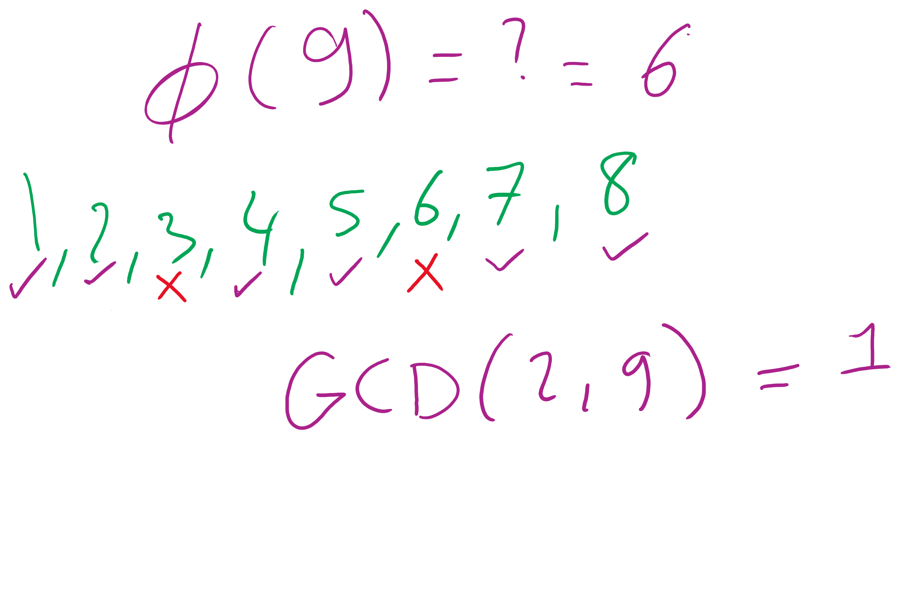
What the φ?
Here, we mean φ to be Euler’s totient
φ(n) is a count of the integers < n that are co-prime to n
I.e., how many k are there such that:
1 <= k <= n AND GCD(n, k) = 1
p and q are prime..
Hence, φ(p) = p - 1 and φ(q) = q -1
Further, φ is multiplicative
Since p and q are prime, they are co-prime, so
φ(p) * φ(q) = φ(p * q) = φ(n)
I won’t detail the proof here...

Slide 31
Greatest Common Divisor
GCD(a, b)
Largest int that evenly divides both a and b
Easiest approach:
BRUTE FORCE
i = min(a, b)
while(a % i != 0 || b % i != 0):
i--
Runtime?
Θ(min(a, b))
Linear!
In value of min(a, b)...
Exponential in n
Assuming a, b are n-bit integers

Slide 32
Euclid’s algorithm
b
GCD(a, b) = GCD(b, a % b)
a % b
a
Notes:
GCD(1071, 462) = 21
If students don't believe me, tell them to make a 1071 x 462 pixel image in paint and try it out

Slide 33
Euclidean example 1
GCD(30, 24)
= GCD(24, 30 % 24)
= GCD(24, 6)
= GCD(6, 24 % 6)
= GCD(6, 0)...
Base case! Overall GCD is 6

Slide 34
Euclidean example 2
= GCD(99, 78)
99 = 78 * 1 + 21
= GCD(78, 21)
78 = 21 * 3 + 15
= GCD(21, 15)
21 = 15 * 1 + 6
= GCD (15, 6)
15 = 6 * 2 + 3
= GCD(6, 3)
6 = 3 * 2 + 0
= 3

Slide 35
Analysis of Euclid’s algorithm
Runtime?
Tricky to analyze, has been shown to be linear in n
Where, again, n is the number of bits in the input

Slide 36
Extended Euclidean algorithm
In addition to the GCD, the Extended Euclidean algorithm (XGCD) produces values x and y such that:
GCD(a, b) = i = ax + by
Examples:
GCD(30,24) = 6 = 30 * 1 + 24 * -1
GCD(99,78) = 3 = 99 * -11 + 78 * 14
Can be done in the same linear runtime!

Slide 37
Extended Euclidean example
= GCD(99, 78)
99 = 78 * 1 + 21
= GCD(78, 21)
78 = 21 * 3 + 15
= GCD(21, 15)
21 = 15 * 1 + 6
= GCD (15, 6)
15 = 6 * 2 + 3
= GCD(6, 3)
6 = 3 * 2 + 0
= 3
3 = 15 - (2 * 6)
6 = 21 - 15
3 = 15 - (2 * (21 - 15))
= 15 - (2 * 21) + (2 * 15)
= (3 * 15) - (2 * 21)
15 = 78 - (3 * 21)
3 = (3 * (78 - (3 * 21))) - (2 * 21)
= (3 * 78) - (11 * 21)
21 = 99 - 78
3 = (3 * 78) - (11 * (99 - 78))
= (14 * 78) - (11 * 99)
= 99 * -11 + 78 * 14
Notes:
Solve for 3 (the end result and GCD)
Then solve for 6, substitute into prev result
Then solve for 15, substitute into prev result
Then solve for 21, substitute into prev result

Slide 38
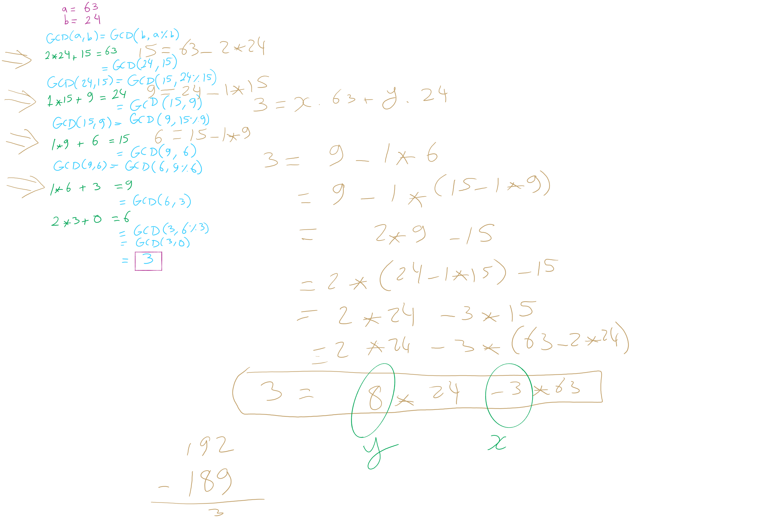
GCD/XGCD Example 1

Slide 39
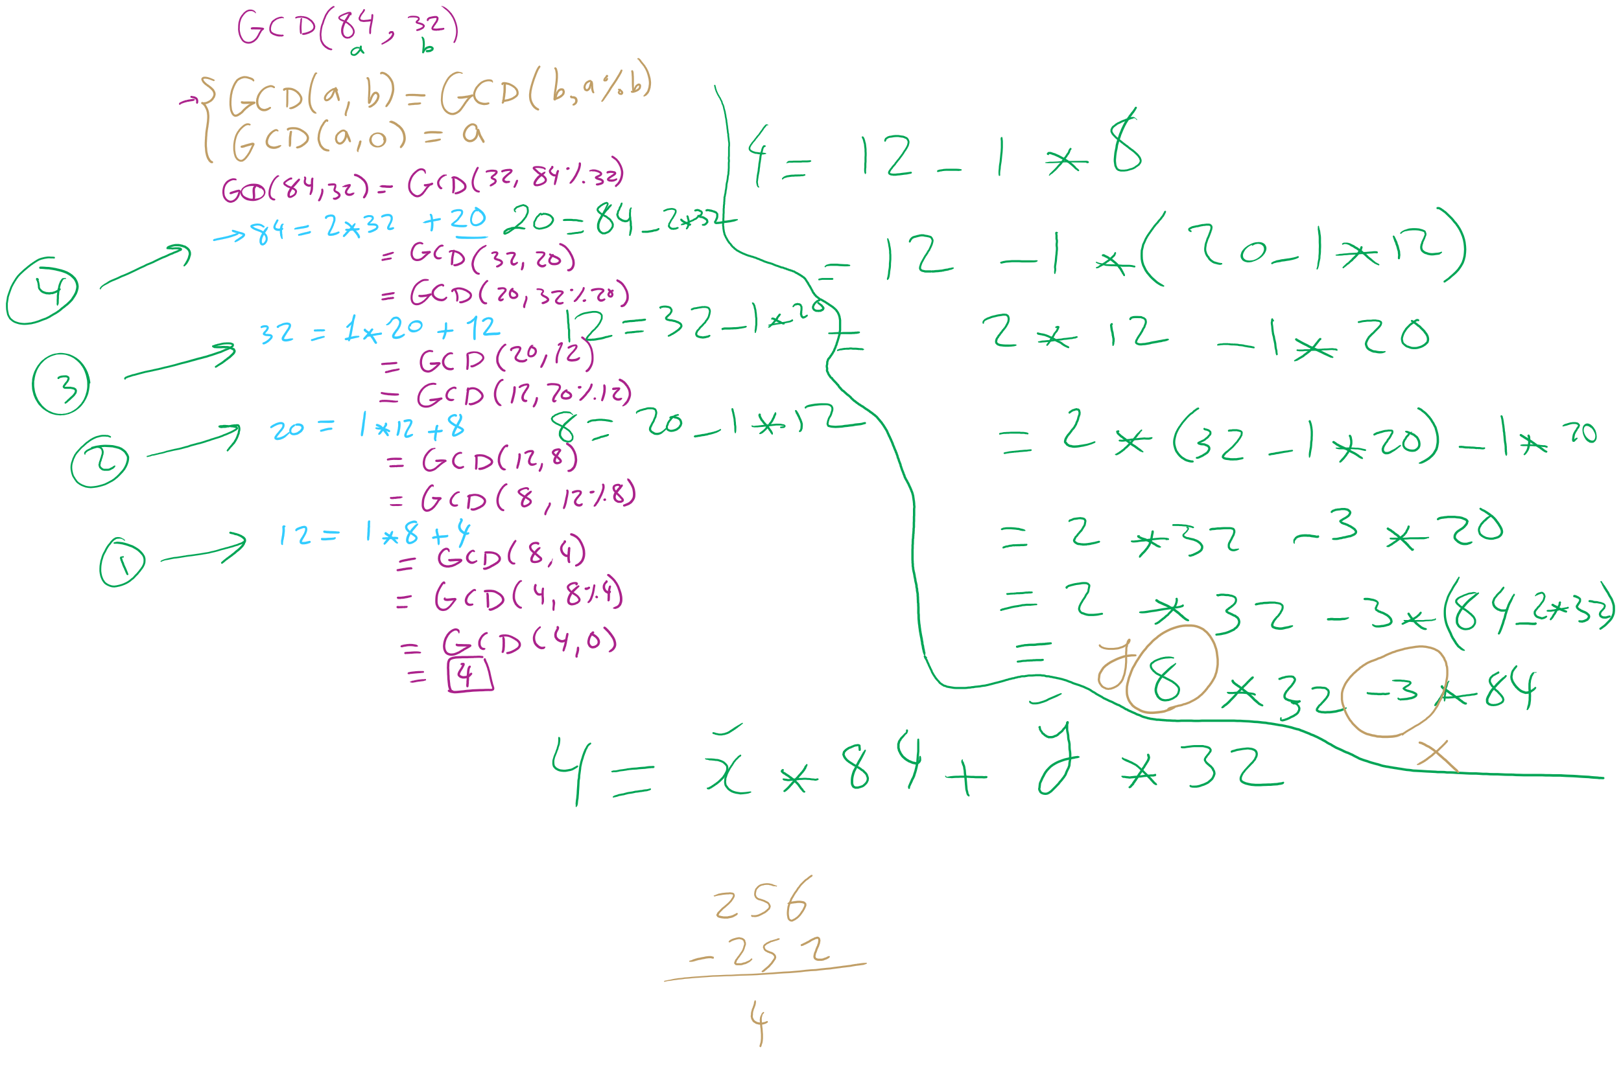
GCD/XGCD Example 2

Slide 40
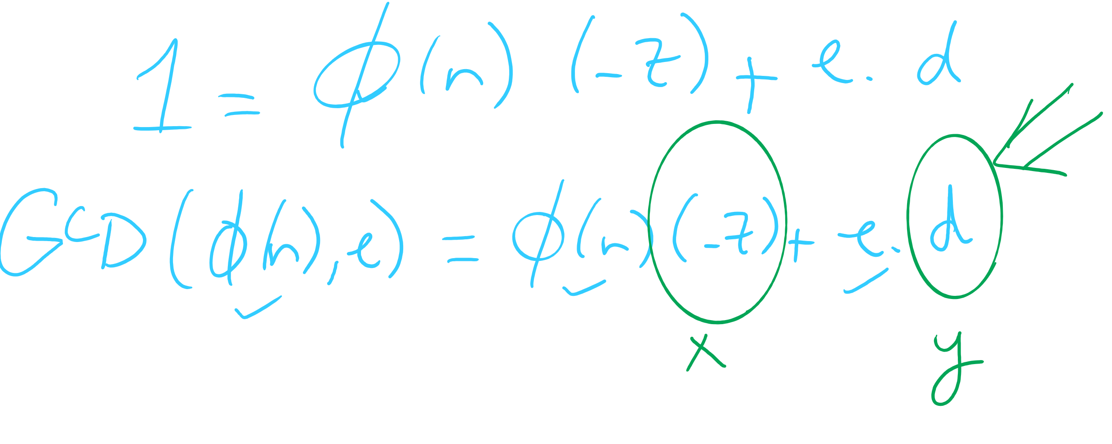
OK, now what about multiplicative inverses mod φ(n)?
d = e⁻¹ mod(φ(n))
Means that d = 1/e mod(φ(n))
Means that e * d = 1 (mod φ(n))
Now, this can be equivalently stated as e * d = z * φ(n) + 1
For some z
Can further restate this as: e * d - z * φ(n) = 1
Or similarly: 1 = φ(n) * (-z) + e * d
How can we solve this?
Hint: recall that we know GCD(φ(n), e) = 1

Slide 41
Use extended Euclidean algorithm!
GCD(a, b) = i = ax + by
Let:
a = φ(n)
b = e
x = -z
y = d
i = 1
GCD(φ(n), e) = 1 = φ(n) * (-z) + e * d
We can compute d in linear time!

Slide 42
RSA keypair example notes
p and q must be prime
n = p * q
φ(n) = (p - 1) * (q - 1)
Choose e such that
1 < e < φ(n) and GCD(e, φ(n)) = 1
Solve XGCD(φ(n), e) = 1 = φ(n) * (-z) + e * d
Compute the ciphertext c as:
c = m^{e} (mod n)
Recover m as:
m = c^{d} (mod n)
Notes:
Ready (( … )**13) % 77 in a python prompt
Advertise public key (n=77, e=37)
Request an encrypted message
What does the mod n mean for possible messages to encrypt??
Show result
Step through key gen process
p = 7, q = 11
n = 77
φ(n) = 60
select e to be 37
co-prime to 60
XGCD(60, 37) = 1 = 60 * -8 + 37 * 13
d = 13

Slide 43
Implementation concerns
Encryption/decryption:
How can we perform efficient exponentiations?
Key generation:
We can do multiplication, XGCD for large integers
What about finding large prime numbers?

Slide 44
Exponentiation
x^{y}
Can easily compute with a simple algorithm:
ans = 1
i = y
while i > 0:
ans = ans * x
i--
Runtime?
Notes:
looking for θ(y) or "linear"

Slide 45
Just like with multiplication, let's consider large integers...
Runtime = # of iterations * cost to multiply
So how many iterations?
Single loop from 1 to y, so linear, right?
What is the size of our input?
n
The bitlength of y…
So, linear in the value of y…
But, increasing n by 1 doubles the number of iterations
Θ(2^{n})
Exponential in the bitlength of y
Notes:
What is the size of our input?
Cost to multiple using gradeschool: n^2

Slide 46
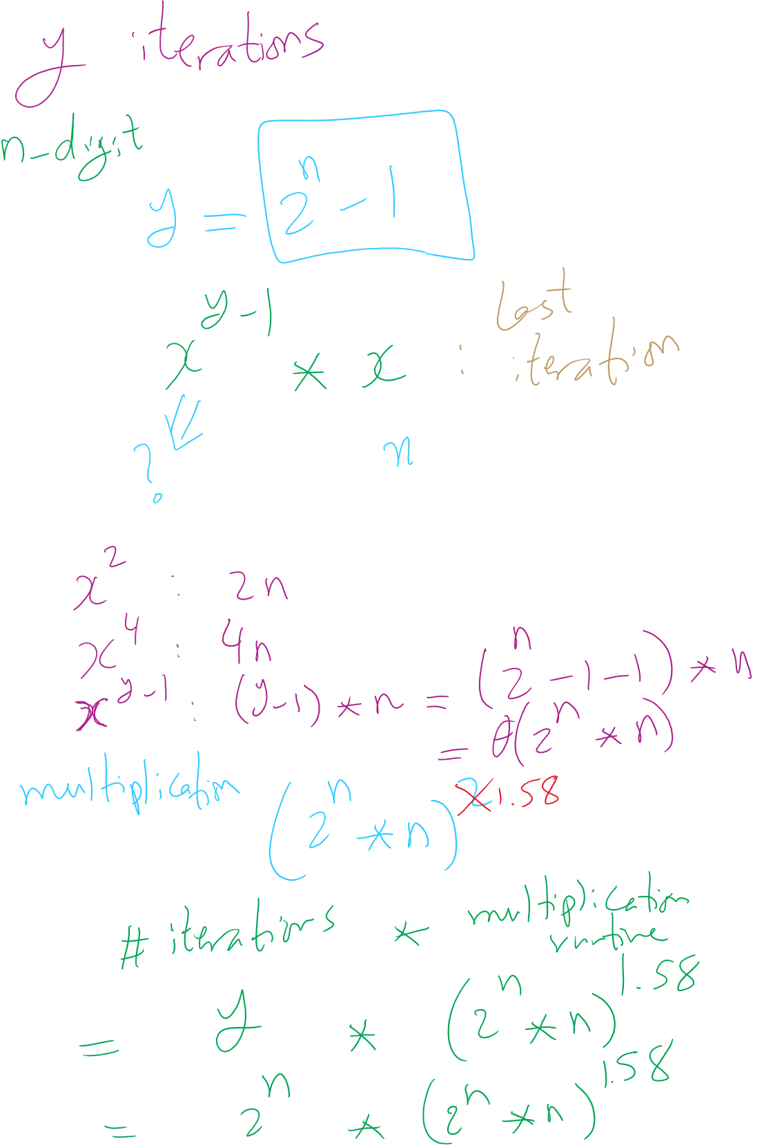
Runtime Analysis

Slide 47
This is RIDICULOUSLY BAD
Assuming 512 bit operands, 2⁵¹²:
13407807929942597099574024998205846127479365820592393377723561443721764030073546976801874298166903427690031858186486050853753882811946569946433649006084096
Assuming we can do mults in 1 cycle…
Which we can’t as we learned last lecture
And further that these operations are completely parallelizable
16 4GHz cores = 64,000,000,000 cycles/second
(2⁵¹² / 64000000000) / (3600 * 24 * 365) =
6.64 * 10¹³⁵ years to compute

Slide 48
This is way too long to do exponentiations!
So how do we do better?
Let’s try divide and conquer!
x^{y} = (x^{(y/2)})²
When y is even, (x^{(y/2)})² * x when y is odd
Analyzing a recursive approach:
Base case?
When y is 1, x^{y} is x; when y is 0, x^{y} is 1
Runtime?

Slide 49
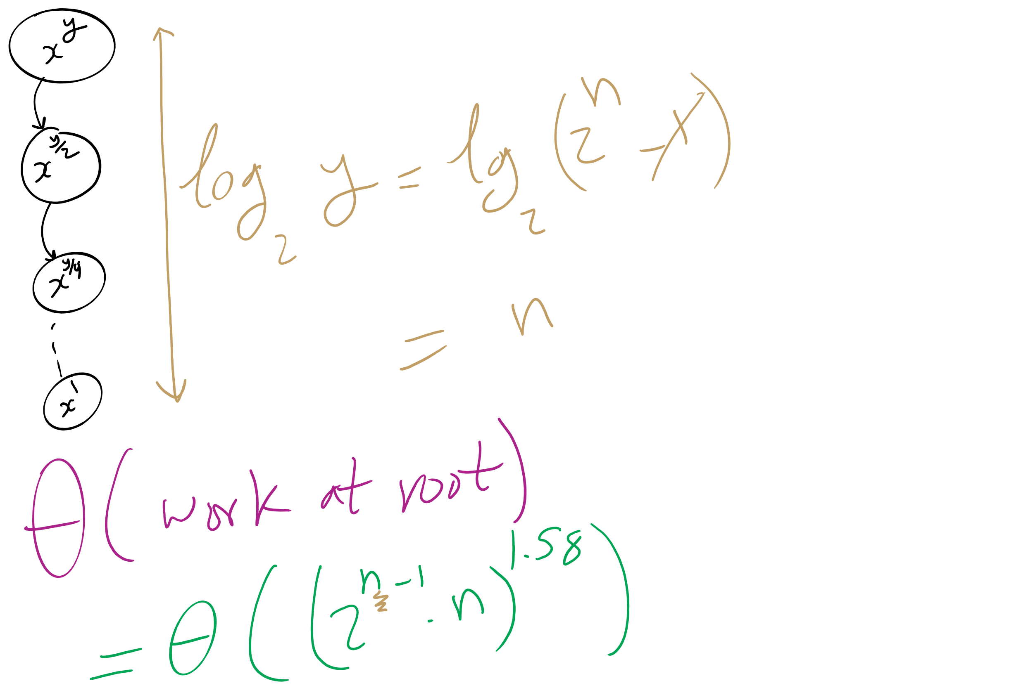
Runtime Analysis

Slide 50
But we need to do expensive mult in each call
We need to do Θ((2^{(n-1)} * n)²) work in just the root call!
Our runtime is dominated by multiplication time
Exponentiation quickly generates HUGE numbers
Time to multiply them quickly becomes impractical

Slide 51
Can we do better?
We go “top-down” in the recursive approach
Start with y
Halve y until we reach the base case
Square base case result
Continue combining until we arrive at the solution
What about a “bottom-up” approach?
Start with our base case
Operate on it until we reach a solution

Slide 52
A bottom-up approach
To calculate x^{y}
ans = 1
foreach bit in y:
ans = ans²
if bit == 1:
ans = ans * x
From most to least significant

Slide 53
Bottom-up exponentiation example
Consider x^{y} where y is 43 (computing x⁴³)
Iterate through the bits of y (43 in binary: 101011)
ans = 1
ans = 1² = 1
ans = 1 * x = x
ans = x² = x²
ans = (x²)² = x⁴
ans = x⁴ * x = x⁵
ans = (x⁵)² = x¹⁰
ans = (x¹⁰)² = x²⁰
ans = x²⁰ * x = x²¹
ans = (x²¹)² = x⁴²
ans = x⁴² * x = x⁴³
Notes:
3⁴³ = 328256967394537077627

Slide 54
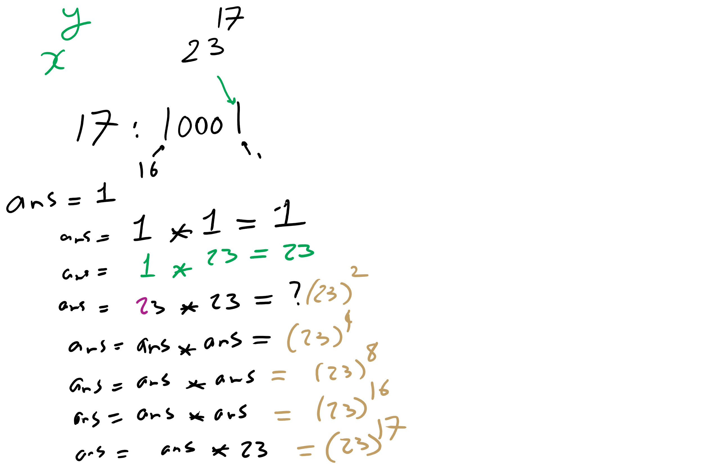
Bottom-up Exponentiation Example 1

Slide 55
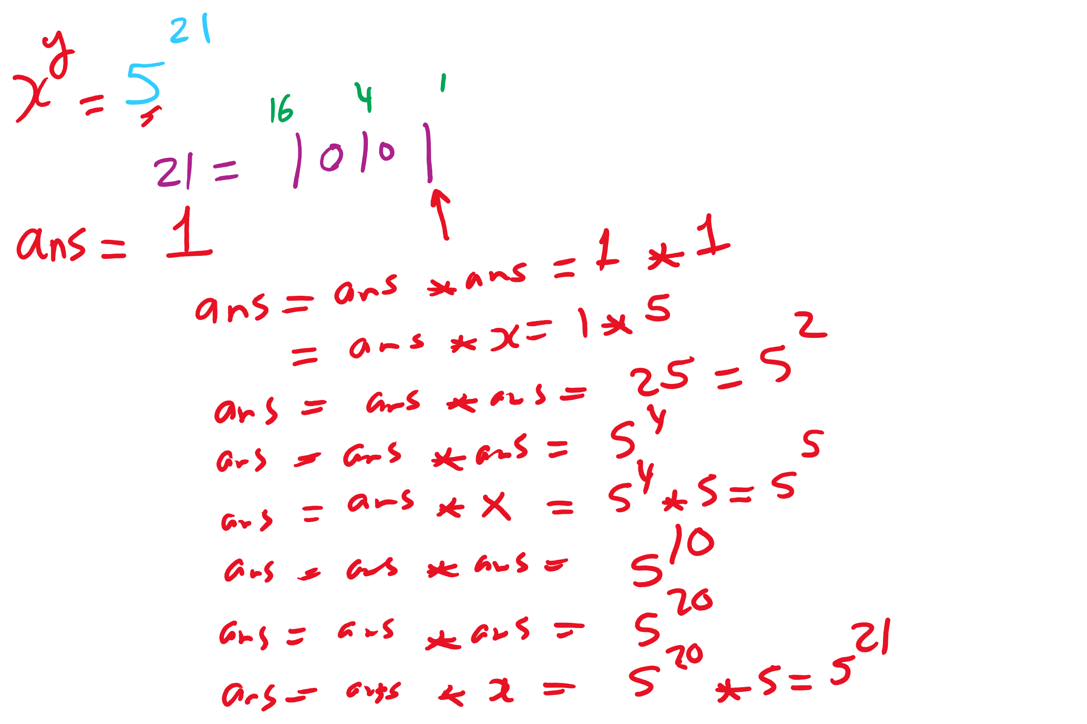
Bottom-up Exponentiation Example 2

Slide 56
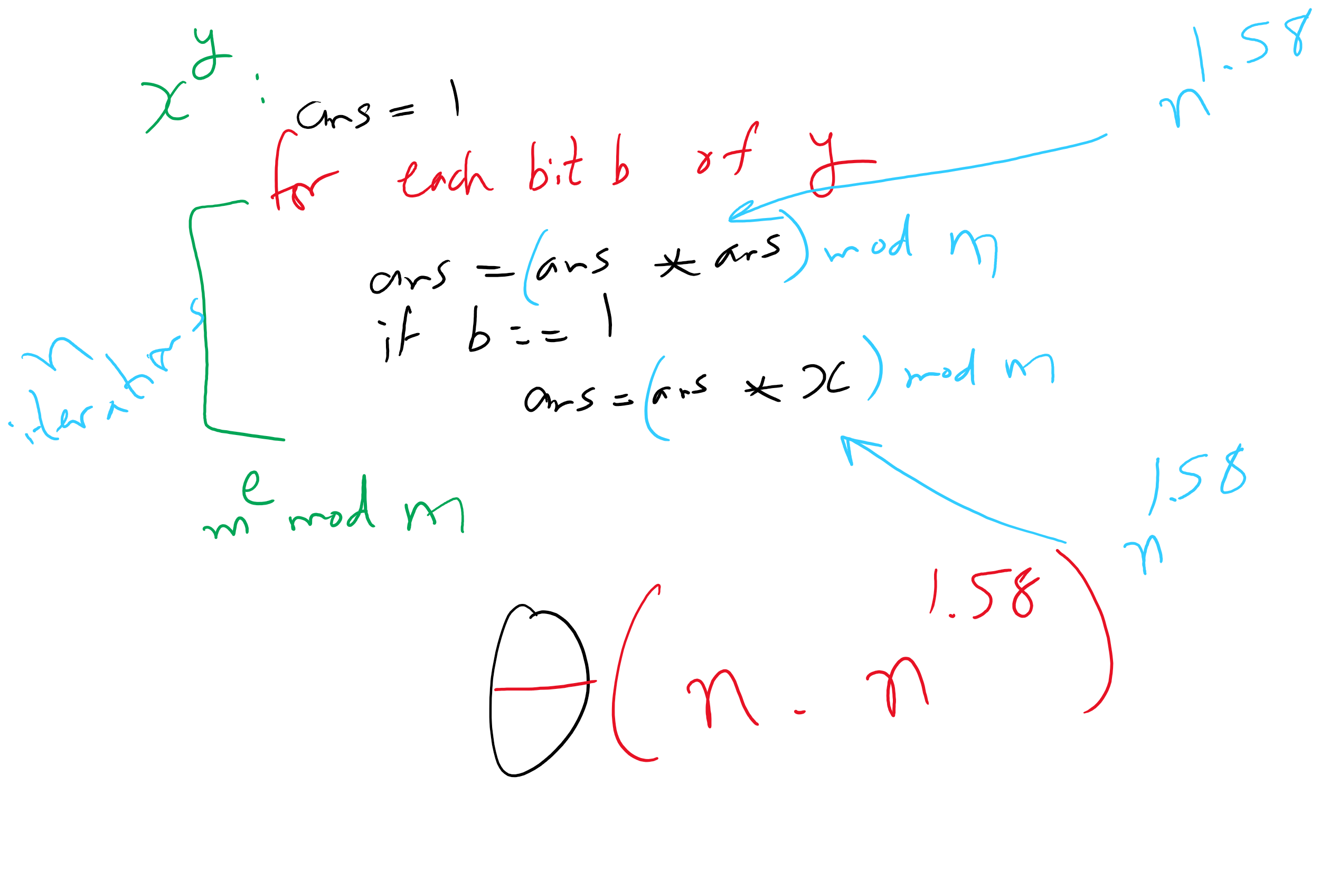
Bottom-up Exponentiation
2
2
2

Slide 57
Does this solve our problem with mult times?
Nope, still squaring ans everytime
We’ll have to live with huge output sizes
This does, however, save us recursive call overhead
Practical savings in runtime

Slide 58
Efficient exponentiation for RSA
Does this solve our problems?
ans = 1
foreach bit in y:
ans = (ans² mod n)
if bit == 1:
ans = (ans * x mod n)
ans = 1
foreach bit in y:
ans = ans²
if bit == 1:
ans = ans * x
How can we improve runtime for RSA exponentiations?
Don’t actually need x^{y}
Just need (x^{y} mod n)

Slide 59
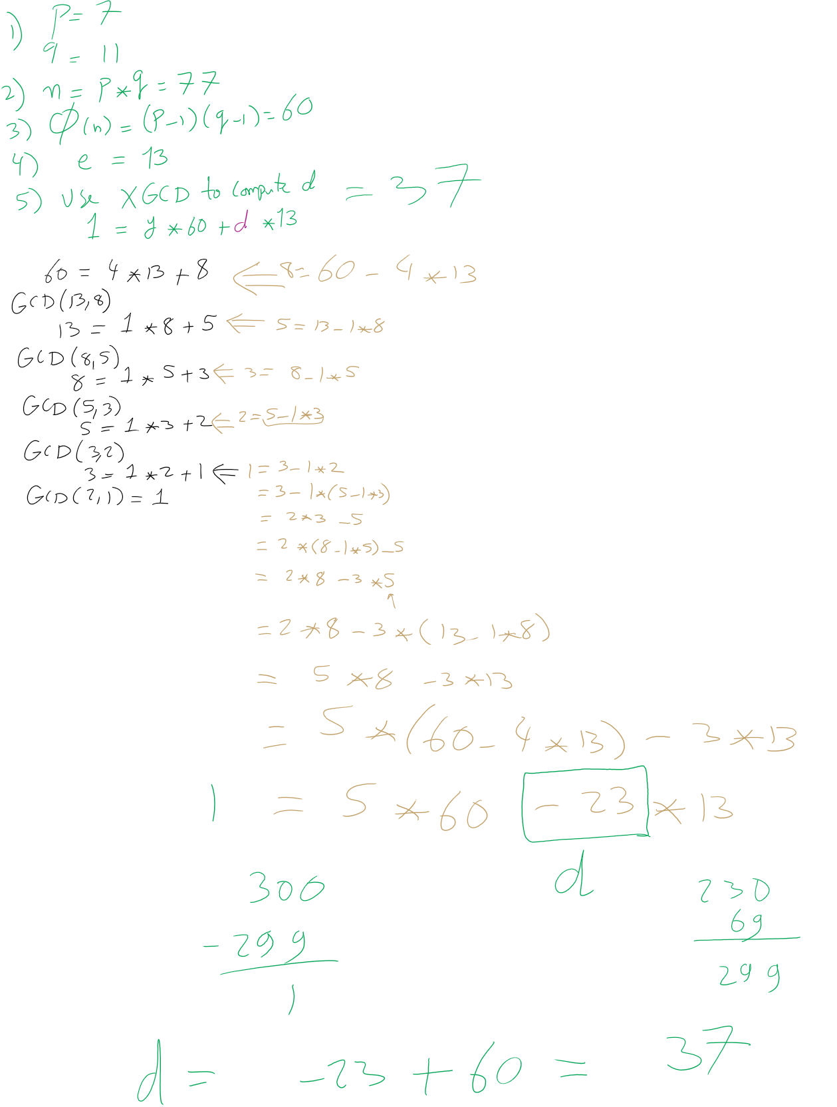
RSA Example 1

Slide 60
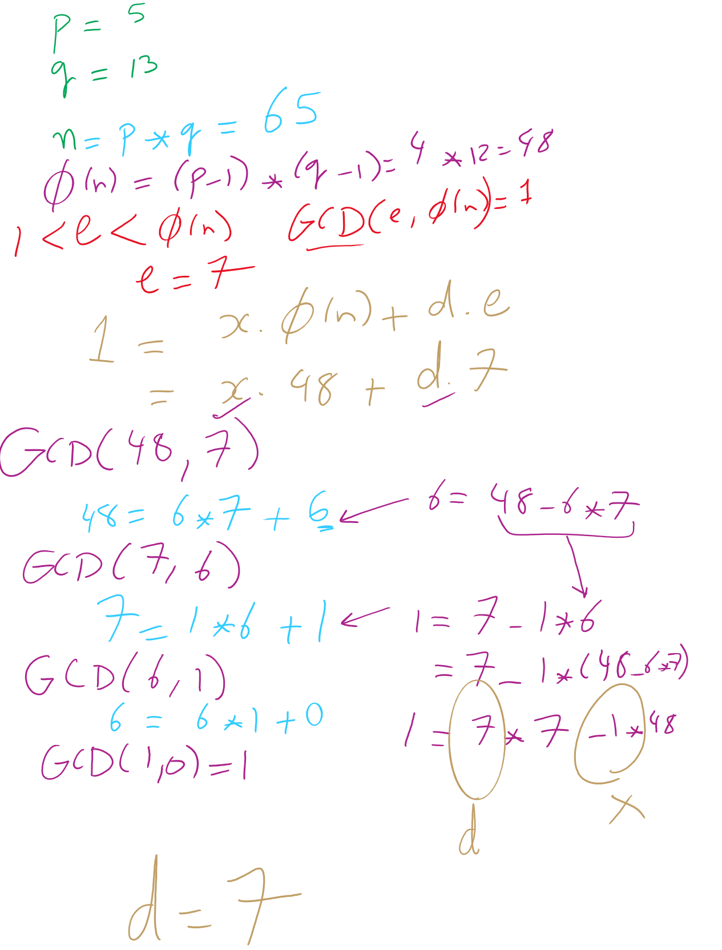
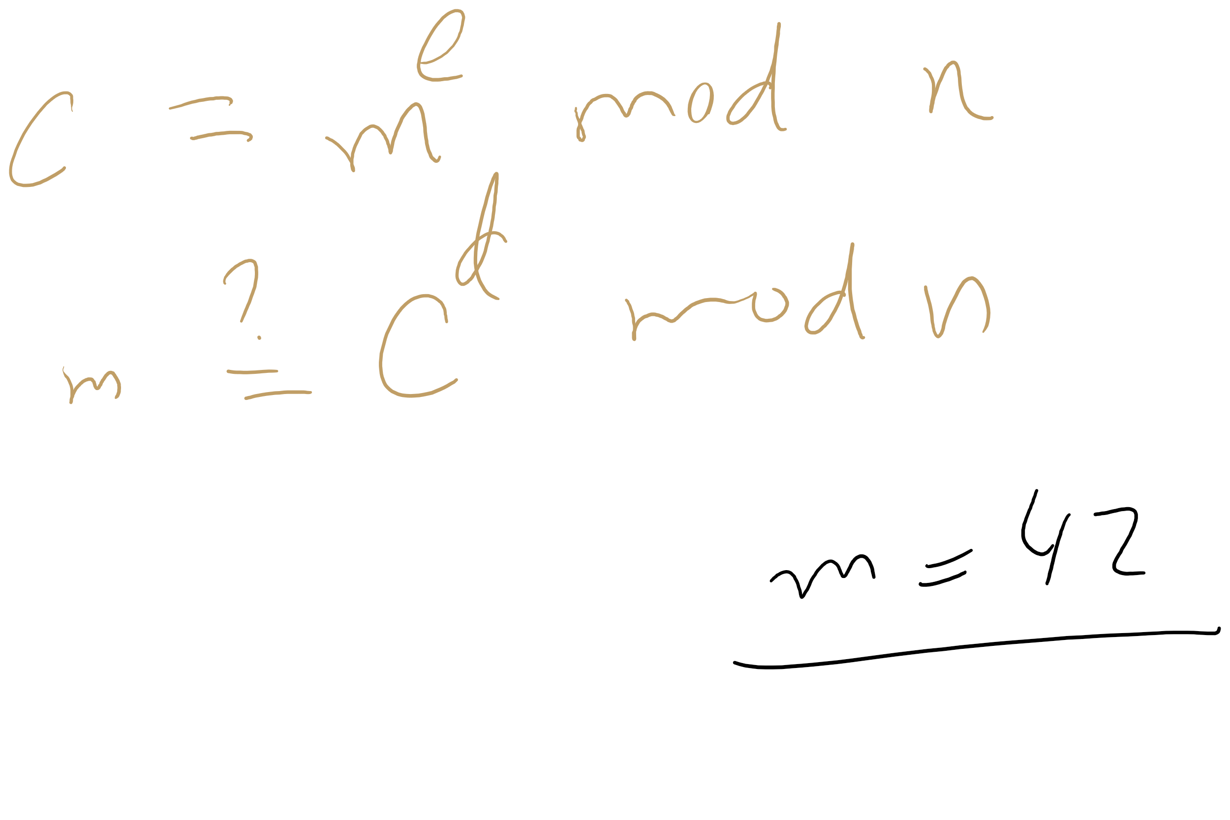
RSA Example 2

Slide 61
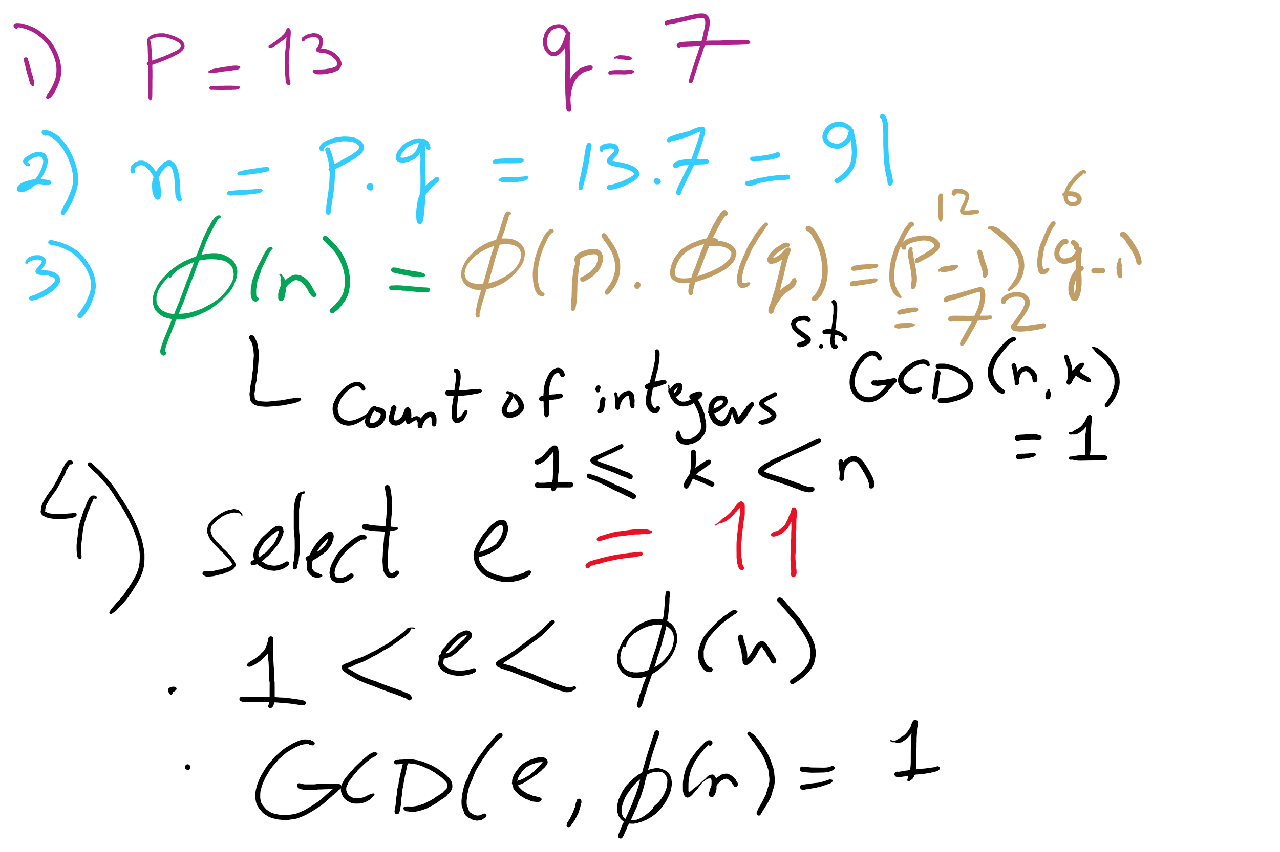
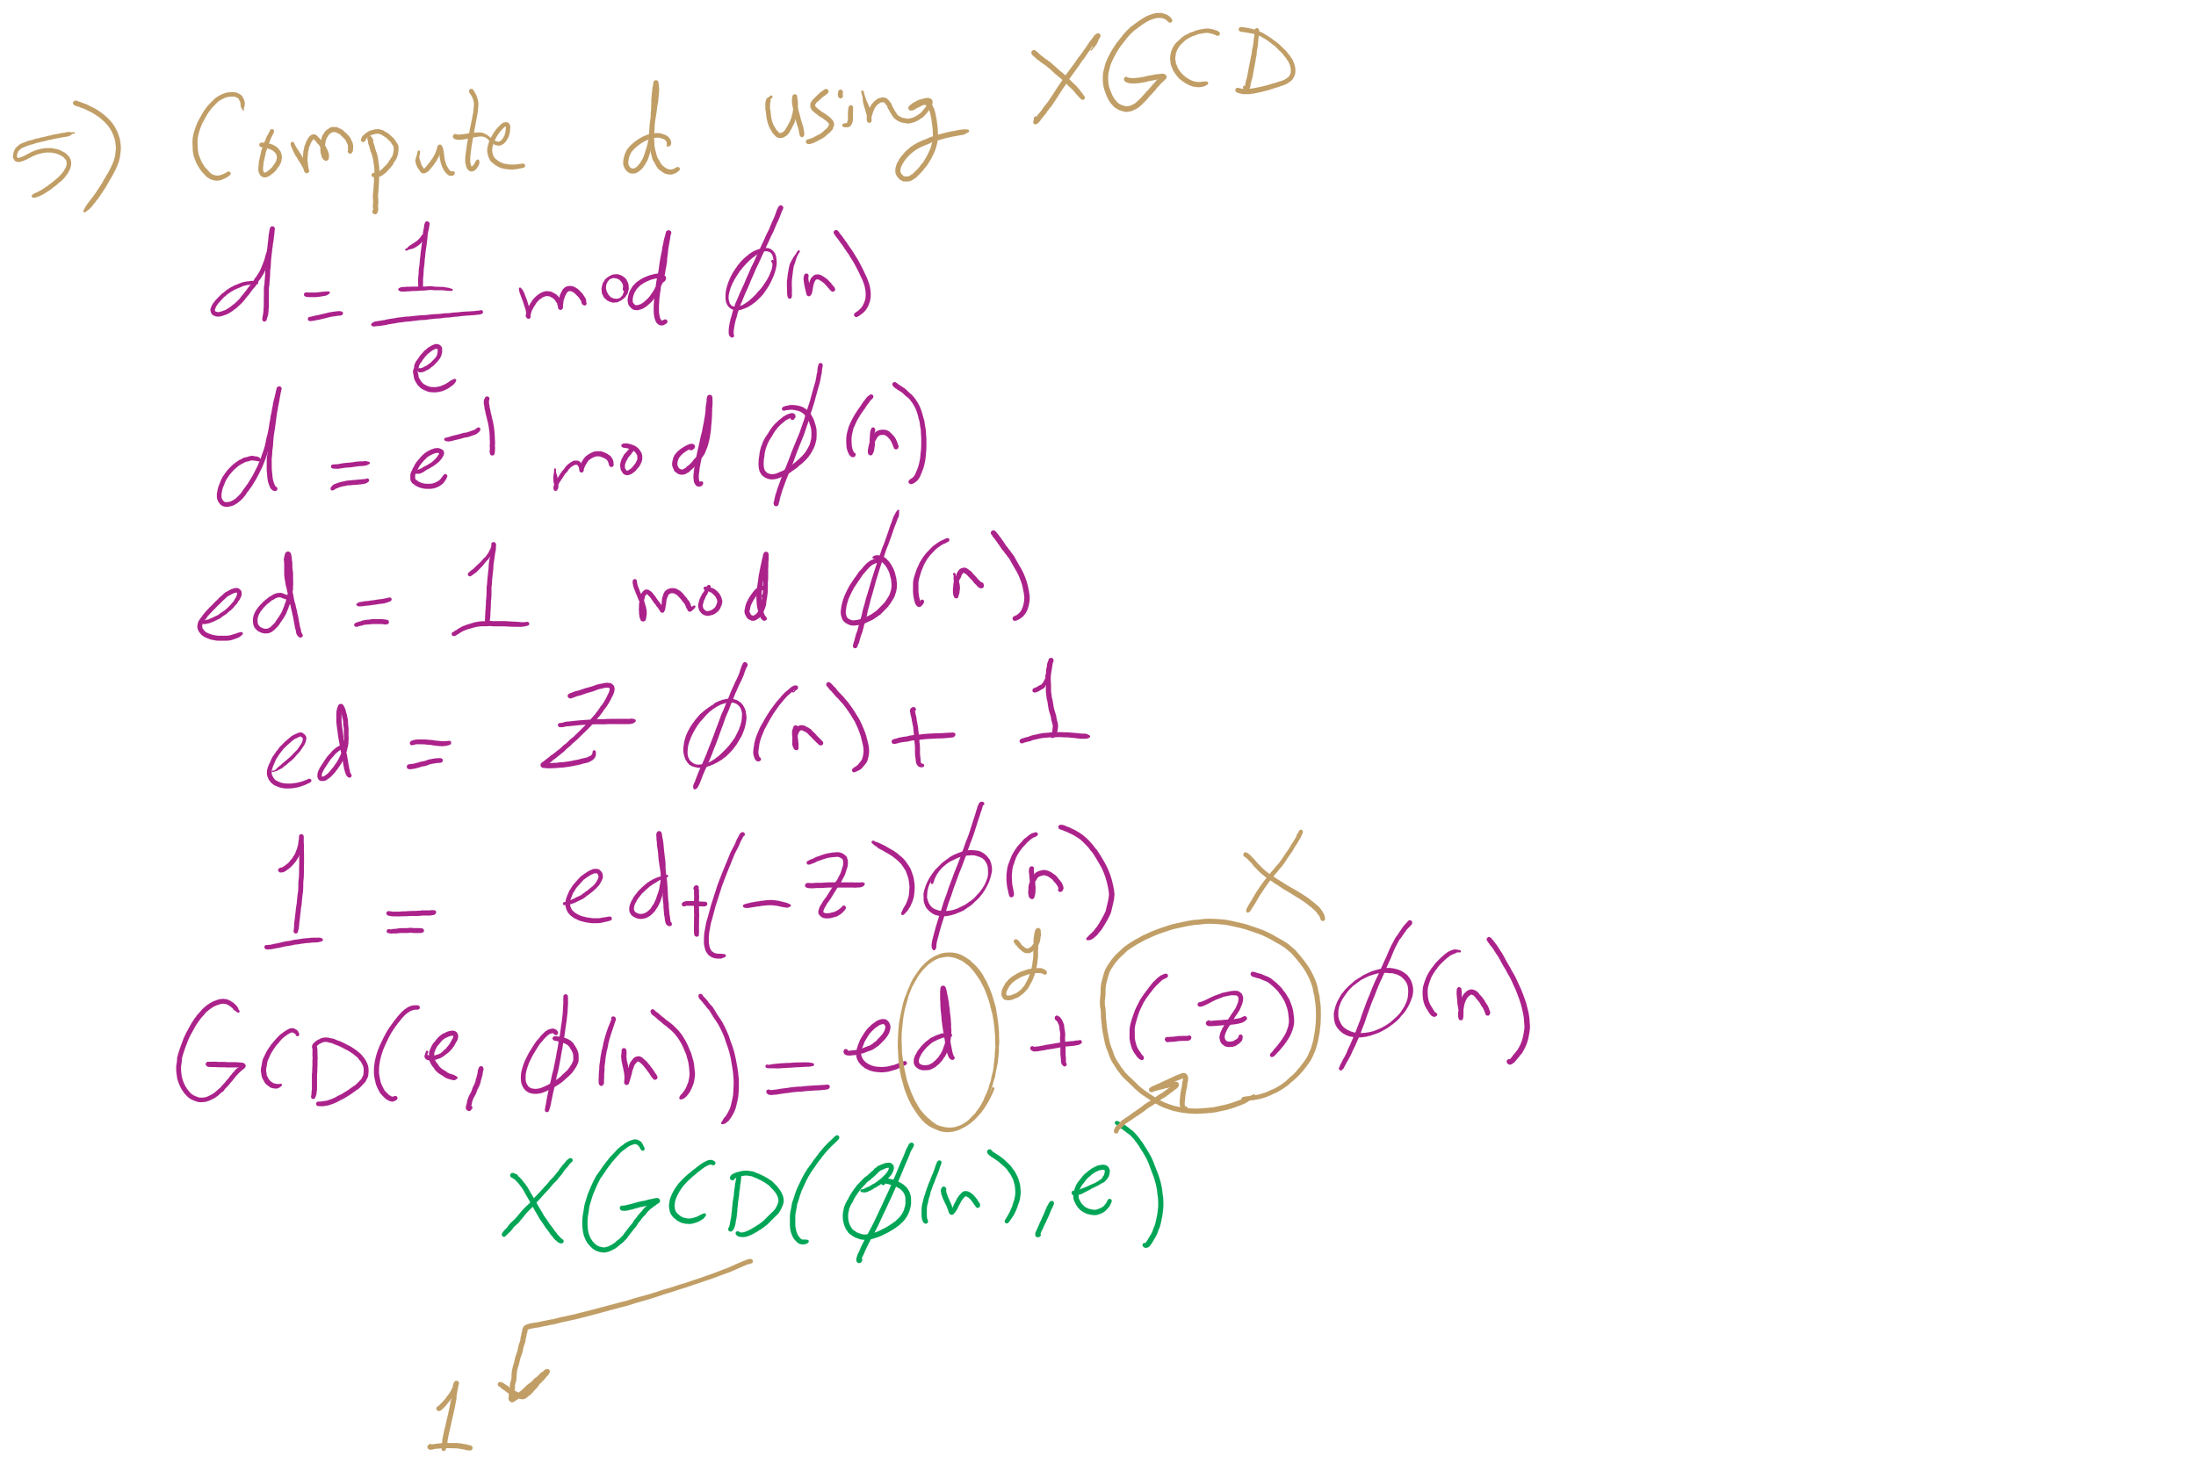
RSA Example 3

Slide 62
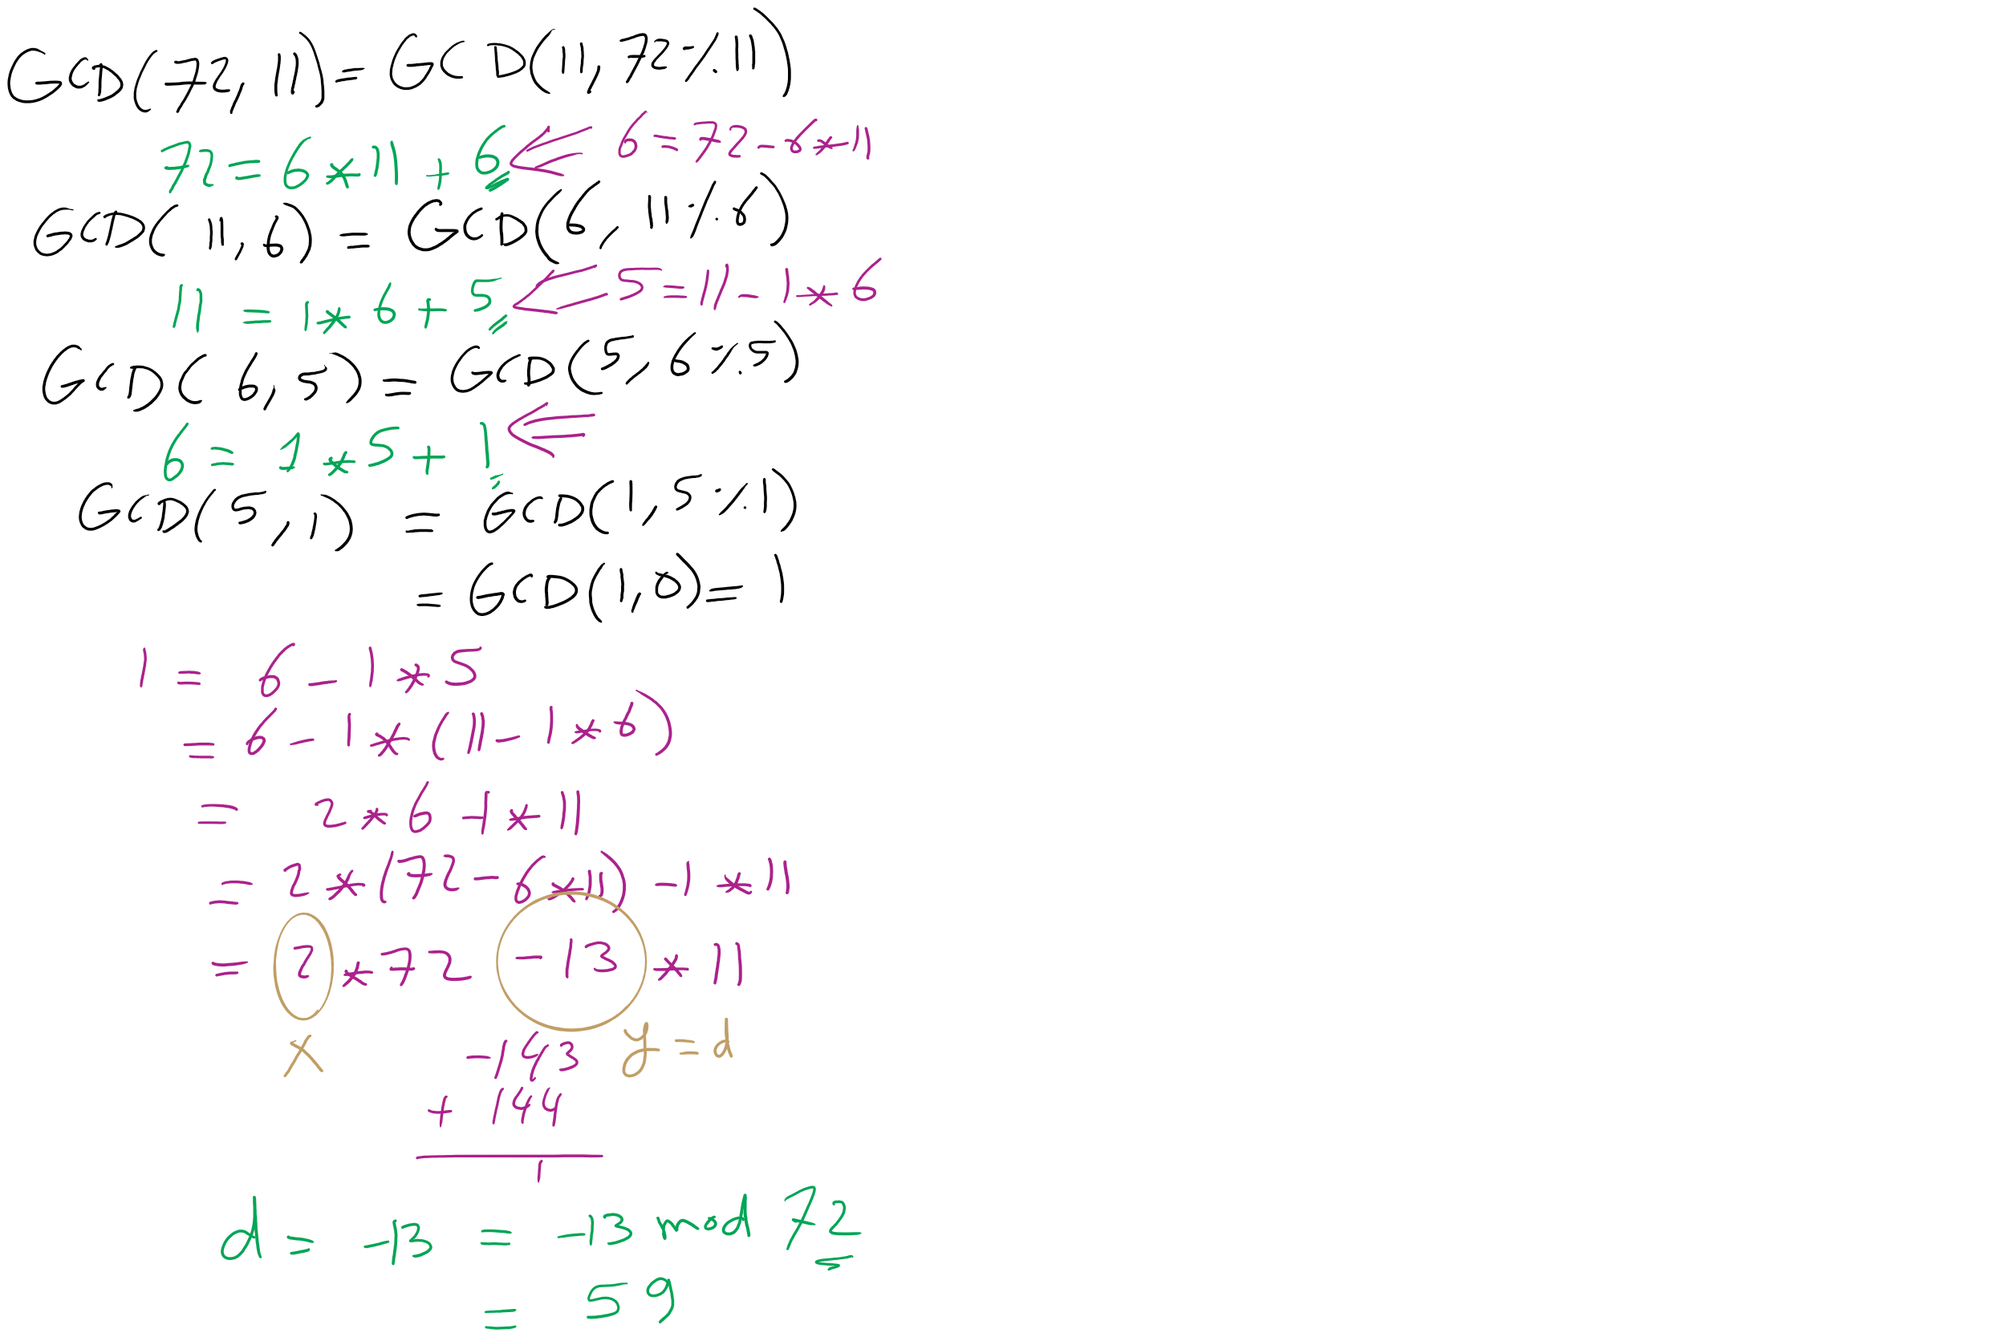
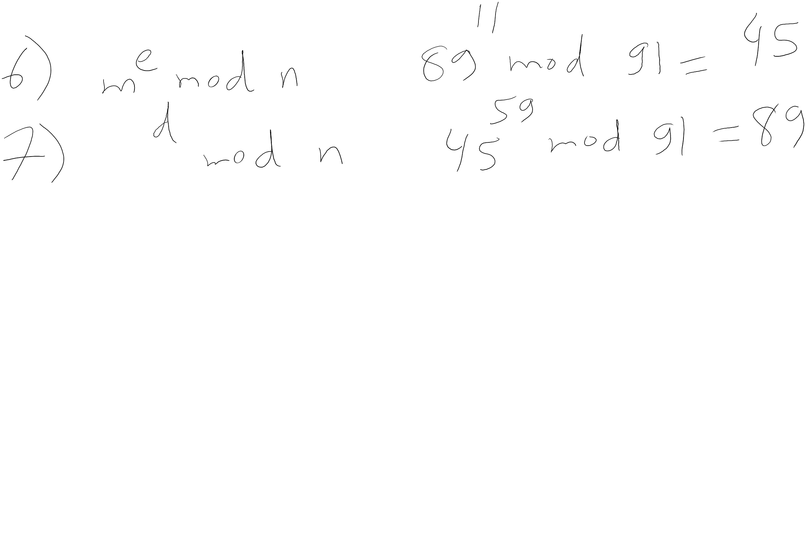
RSA Example 3 (contd.)

Slide 63
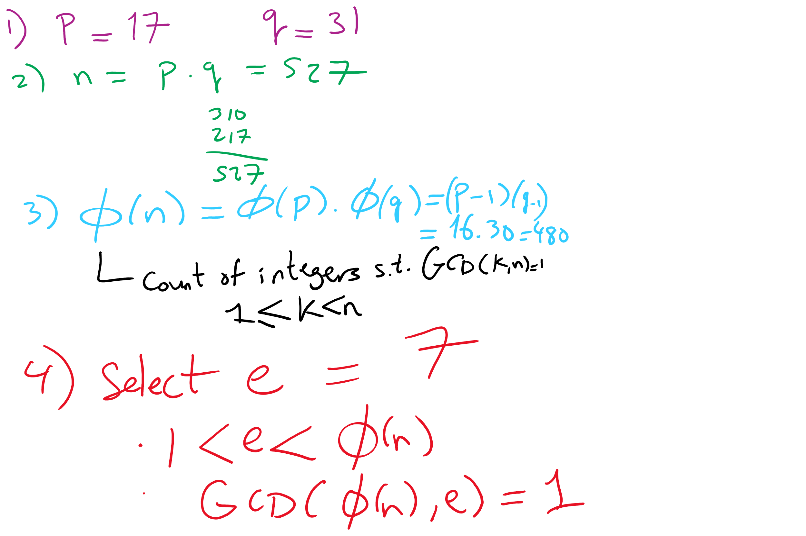
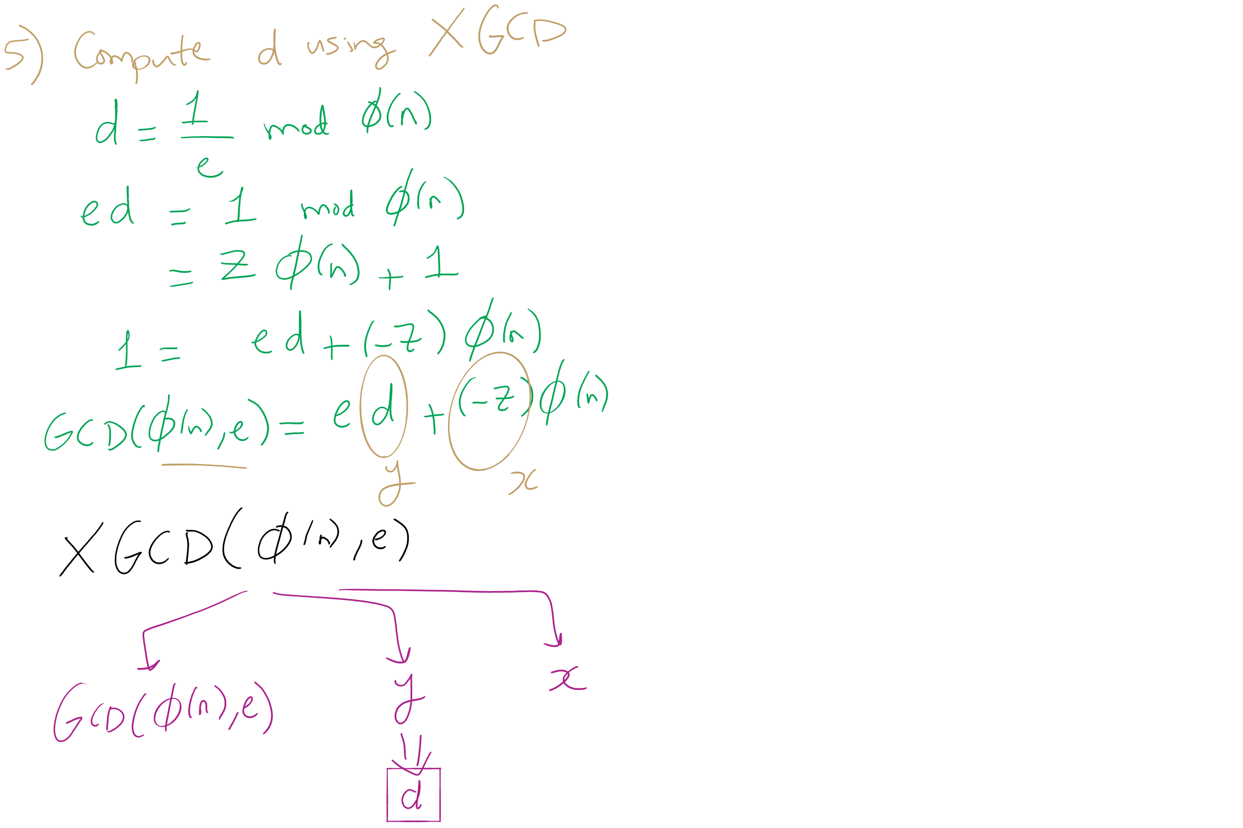
RSA Example 4

Slide 64
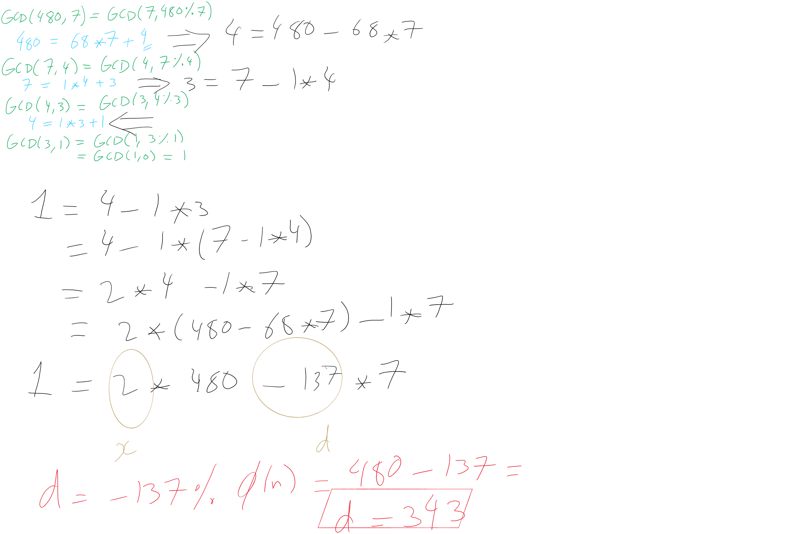
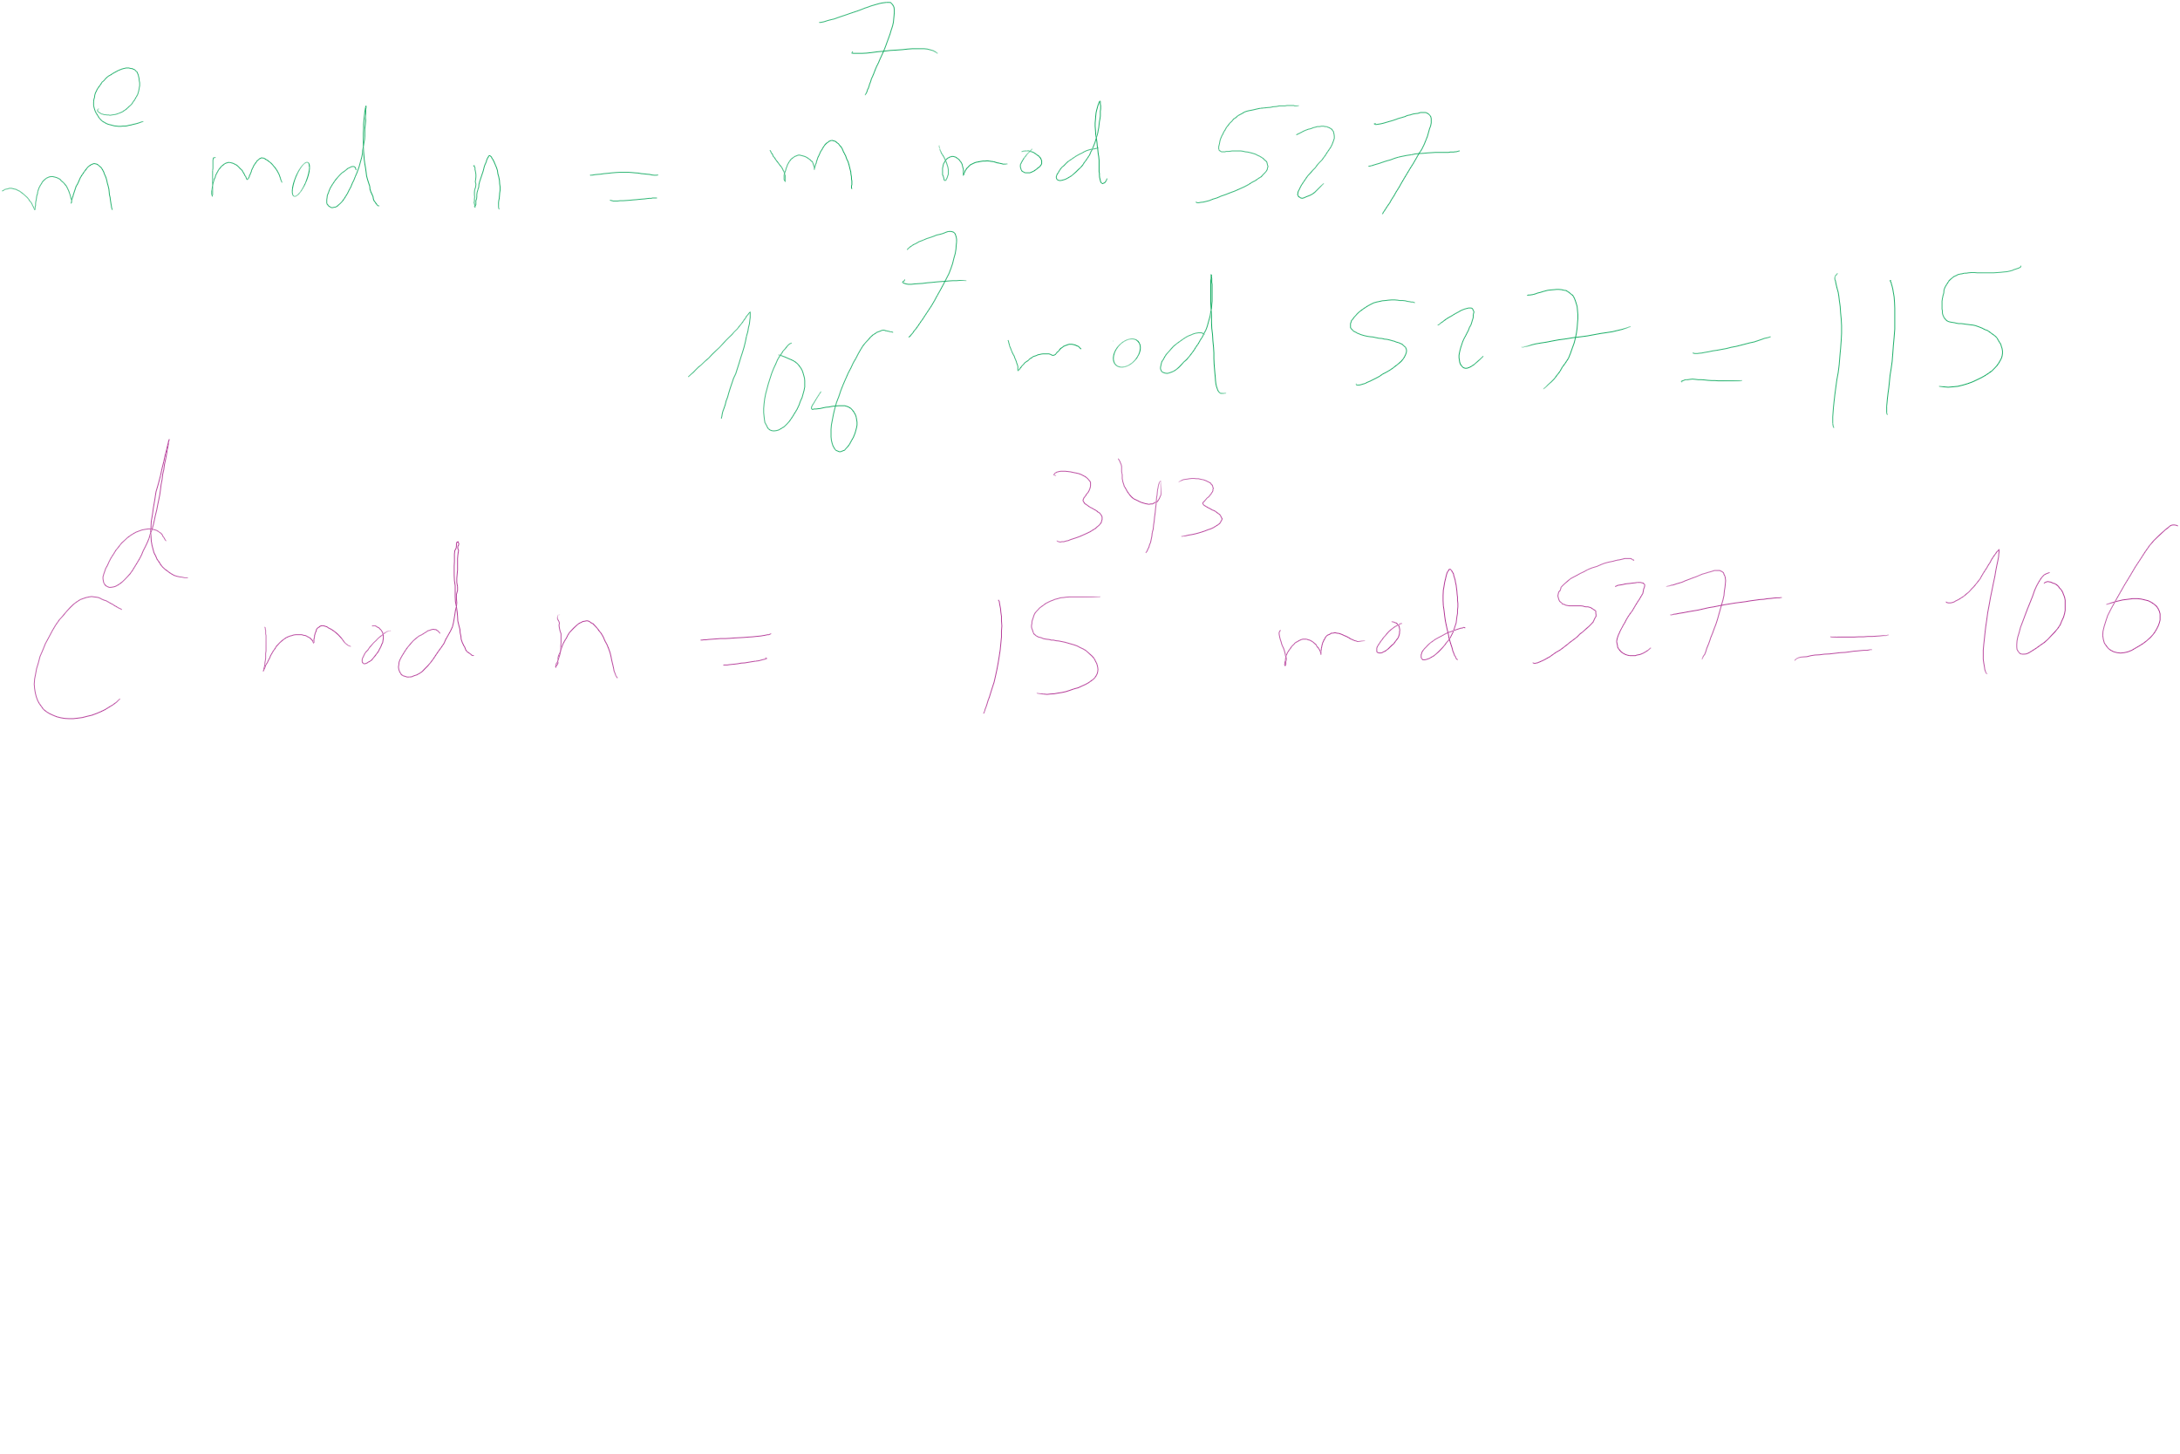
RSA Example 4 (contd.)

Slide 65
OK, but how does m^{ed} = m mod n?
Feel free to look up the proof using Fermat’s little theorem
Knowing this proof is NOT required for the course
Knowing how to generate RSA keys and encrypt/decrypt IS
For this course, we’ll settle with our example showing that it does work

Slide 66
Why is RSA secure?
4 avenues of attack on the math of RSA were identified in the original paper:
Factoring n to find p and q
Determining φ(n) without factoring n
Determining d without factoring n or learning φ(n)
Learning to take e^{th} roots modulo n

Slide 67
Factoring n
To the best of our knowledge, this is hard
A 768 bit RSA key was factored one time using the best currently known algorithm
Took 1500 CPU years
2 years of real time on hundreds of computers
Hence, large keys are pretty safe
2048 bit keys are a pretty good bet for now

Slide 68
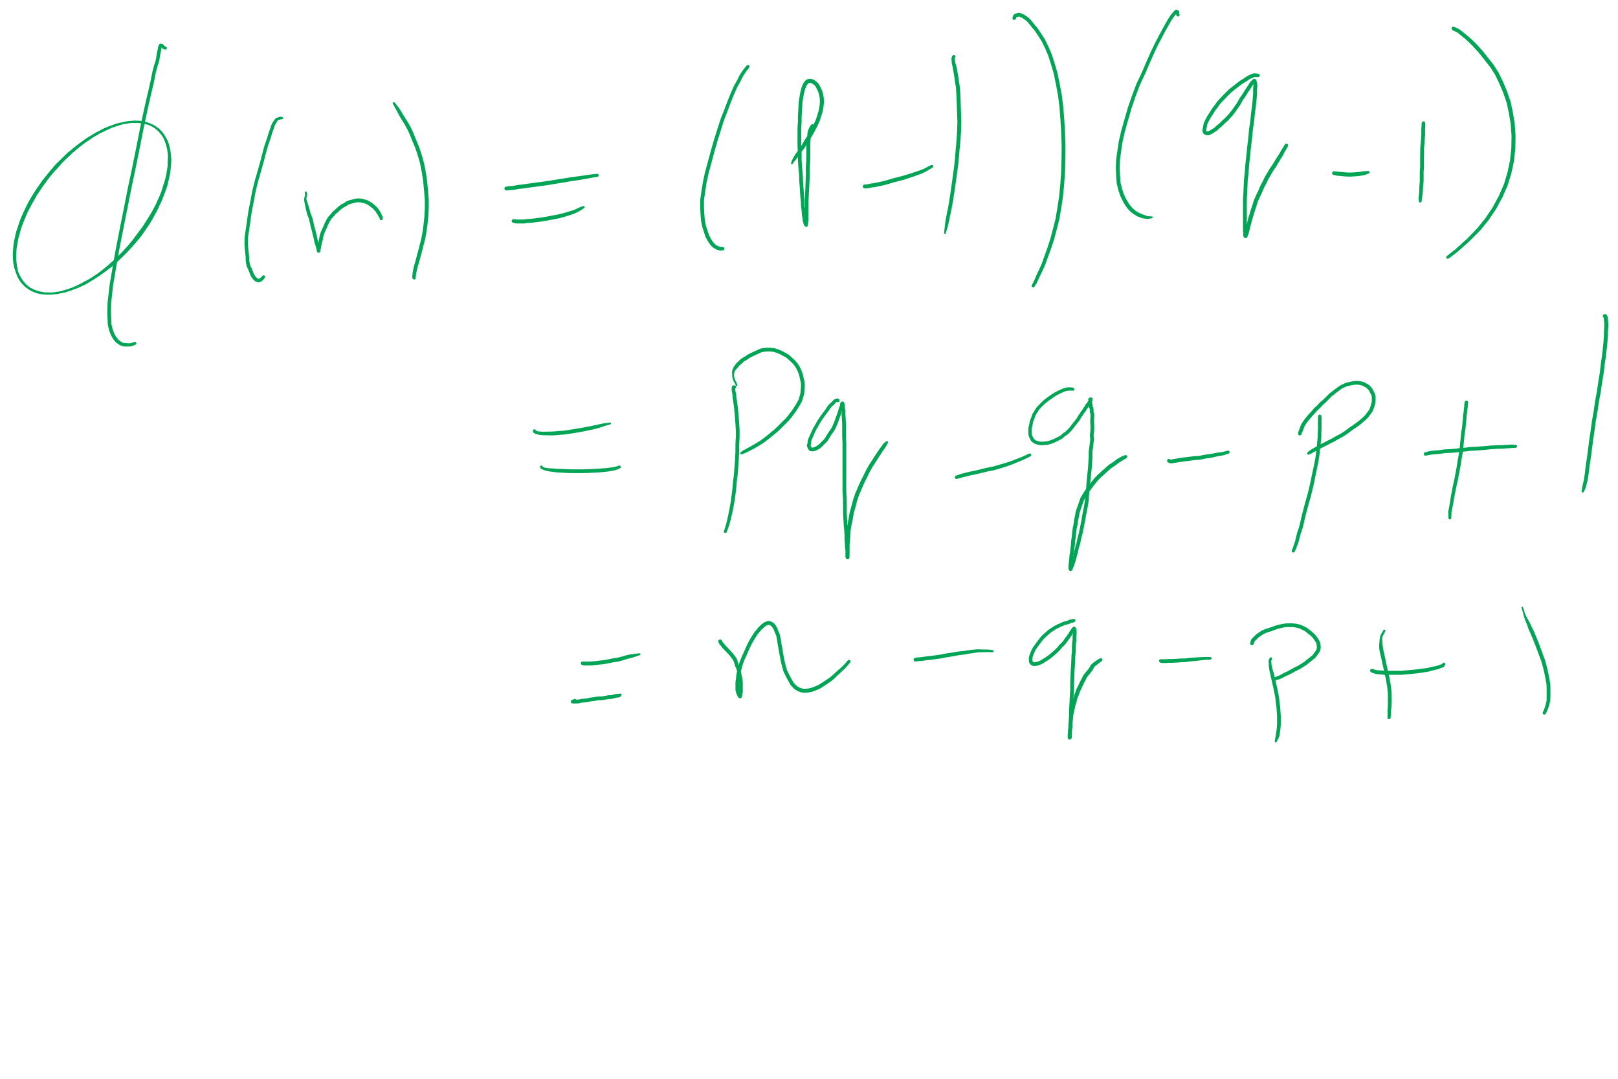
What about determining φ(n) without factoring n?
Would allow us to easily compute d because ed = 1 mod φ(n)
Note:
φ(n) = n - p - q + 1
φ(n) = n - (p + q) + 1
(p + q) = n + 1- φ(n)
(p + q) - (p - q) = 2q
Now we just need (p - q)...
(p - q)² = p² - 2pq + q²
(p - q)² = p² + 2pq + q² - 4pq
(p - q)² = (p + q)² - 4pq
(p - q)² = (p + q)² - 4n
(p - q) = √((p + q)² - 4n)
If we can figure out φ(n) efficiently, we could factor n efficiently!

Slide 69
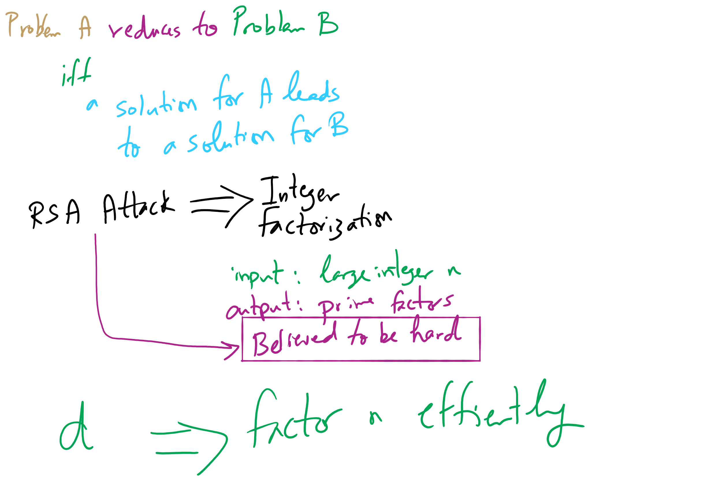
Reduction and RSA Security

Slide 70
Determining d without factoring n or learning φ(n)?
If we know, d, we can get a multiple of φ(n)
ed = 1 mod φ(n)
ed = kφ(n) + 1
For some k
ed - 1 = kφ(n)
It has been shown that n can be efficiently factored using any multiple of φ(n)
Hence, this would provide another efficient solution to factoring!

Slide 71
Learning to take e^{th} roots modulo n
Conjecture was made in 1978 that breaking RSA would yield an efficient factoring algorithm
To date, it has been not been proven or disproven

Slide 72
This all leads to the following conclusion
Odds are that breaking RSA efficiently implies that factoring can be done efficiently.
Since factoring is probably hard, RSA is probably safe to use.

Slide 73
RSA Implementation concerns
Encryption/decryption:
How can we perform efficient exponentiations?
Key generation:
We can do multiplication, XGCD for large integers
What about finding large prime numbers?

Slide 74
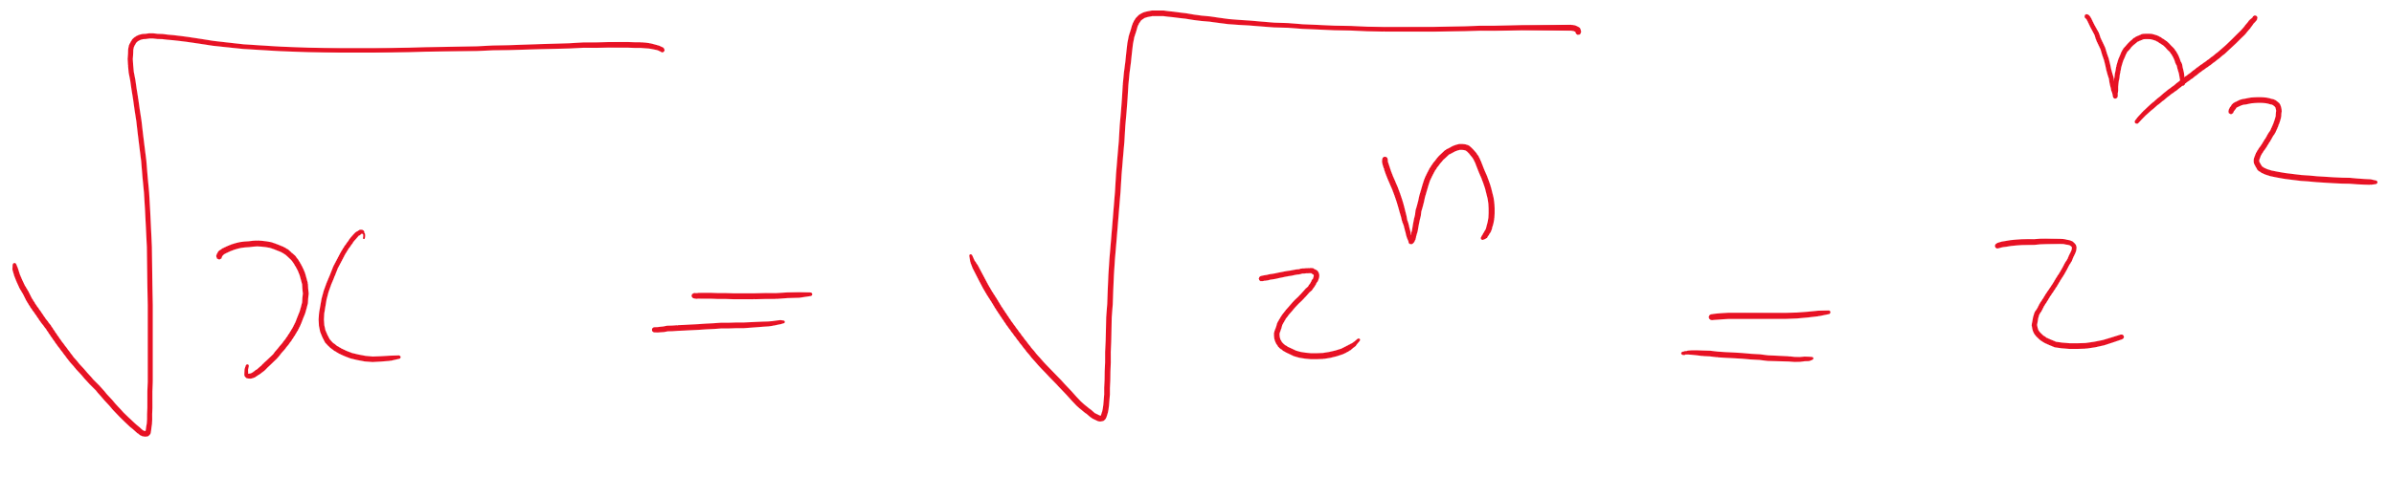
Prime testing option 1: BRUTE FORCE
Try all possible factors of x
1 .. sqrt(x)
aka 1 .. sqrt(2^{size(x)})
For a total of 2^{(size(x)/2)} factor checks
A factor check should take about the same amount of time as multiplication
size(x)²
So our runtime is Θ(2^{(size(x)/2)} * size(x)²)

Slide 75
Option 2: A probabilistic approach
Need a method test : Z×Z → {T, F}
If test(x, a) = F, x is composite based on the witness a
If test(x, a) = T, x is probably prime based on the witness a
To test a number x for primality:
Randomly choose a witness a
if test(x, a) = F, x is composite
if test(x, a) = T, loop
Possible implementations of test(x, a):
Miller-Rabin, Fermat’s, Solovay–Strassen
often probability ≈ 1/2
k repetitions leads to probability that x is composite ≈ 1/2^{k}

Slide 76
RSA still slower (generally) than symmetric encryption
If only we could have the speed of symmetric encryption without the key distribution woes!
What if we transmitted symmetric crypto keys with RSA?
RSA Envelopes!
Going back to Alice and Bob
Alice generates a random AES key
Alice encrypts her message using AES with this key
Alice encrypts the key using Bob’s RSA public key
Alice sends the encrypted message and encrypted key to Bob
Bob decrypts the AES key using his RSA private key
Bob decrypts the message using the AES key

Slide 77


RSA Envelope example
KEY_{AES} = rand.nextInt(0, 2²⁵⁶)
KEY_{AES}
KEY_{AES}
SECRET MESSAGE
SECRET MESSAGE
BOB_{PUB}
BOB_{PRIV}
KEY_{AES}
BOB_{PUB}
KEY_{AES}

Slide 78
Another fun use of RSA...
Notice that encrypting and decrypting are inverses
m^{ed} = m^{de} (mod n)
We can “decrypt” the message first with a private key
Then recover the message by “encrypting” with a public key
Note that anyone can recover the message
However, they know the message must have come from the owner of the private key
Using RSA this way creates a digital signature

Slide 79
Do RSA signatures need to be slow?
We encrypted symmetric crypto keys before to speed things up…
We'll need another crypto primitive to help out here
Cryptographically secure hash functions

Slide 80
Hashing for security (similarities)
Cryptographically secure hash functions share properties with the hash functions we've already talked about in recitations:
Map from some input domain to a limited output range
Though output ranges are much larger here
For modern algorithms 224-512 bit output sizes
Time required to compute the hash is proportional to the size of the item being hashed
Though, practically, cryptographic hash functions are more expensive
Notes:
Discuss use of crypto hashing to implement a hash table

Slide 81
Now just sign a hash of the message!
H_{BOB} = h
MSG. DEF. FROM BOB
H_{ALICE} = h
MSG. DEF. FROM BOB
Same?
MSG. DEF. FROM BOB
MSG. DEF. FROM BOB
BOB_{PRIV}
BOB_{PUB}
H_{BOB}
BOB_{PRIV}
H_{BOB}

Slide 82
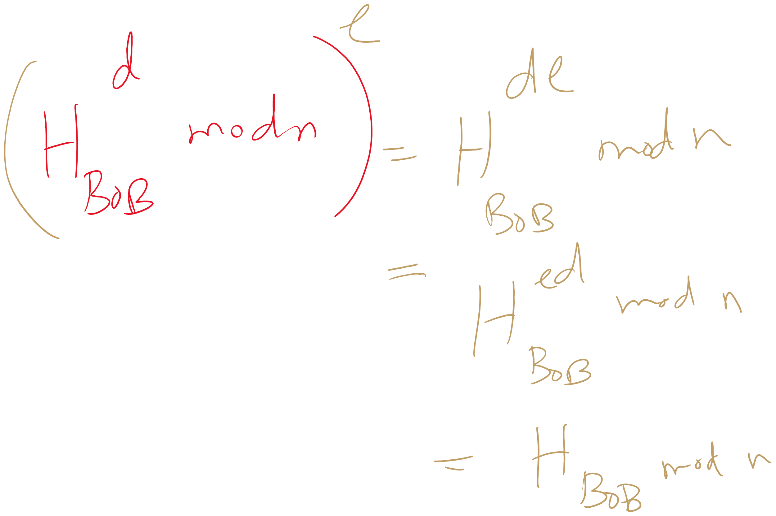
Why does it work?

Slide 83
What about collisions?
If Bob signs a hash of the message “I’ll see you at 7”
It could appear that Bob signed any message whose hash collides with “I’ll see you at 7”...
If h(“I’ll see you at 7”) == h(“I’ll see you after I rob the bank”), Bob could be in alot of trouble
An attack like this helped the Flame malware to spread
This is also the reason Google is aiming to deprecate SHA-1
Notes:
Discuss using modular hashing for digital signatures

Slide 84
Hashing for security (differences)
This is why cryptographically secure hash functions must support additional properties:
It should be infeasible to find two different messages with the same hash value
It should be infeasible to recover a message from its hash
Should require a brute force approach
Small changes to a message should change the hash value so extensively that the new hash value appears uncorrelated with the old hash value

Slide 85
Public key isn’t perfect
What do you do when a private key is compromised?

Slide 86
Final note about crypto
NEVER IMPLEMENT YOUR OWN CRYPTO
Use a trusted and tested library.

Slide 87
Please submit your reflections by using the CourseMIRROR App
If you are having a problem with CourseMIRROR, please send an email to coursemirror.development@gmail.com
Notes:
All right!
Upcoming Due Dates at A Glance

